Slide 2

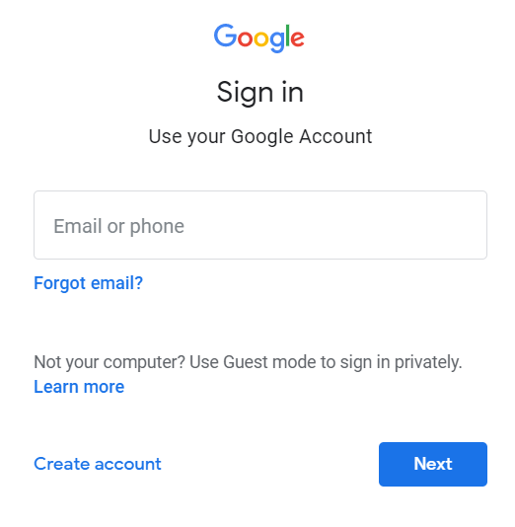

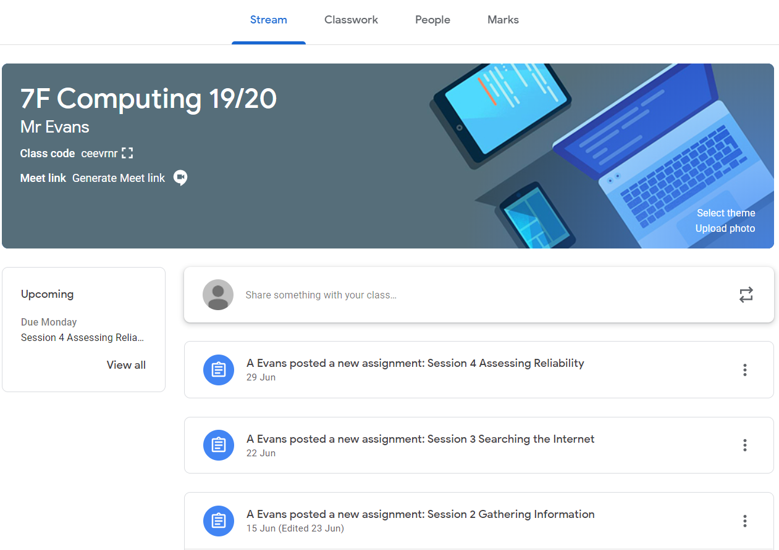
Year 7 Computing Half Term 1
Using Computers
Key terms
Term | Definition
Email | Electronic mail is a method of exchanging messages between people using electronic devices.
Password | A string of characters that allows access to a computer system or service.
Google Drive | A cloud storage platform where you can store files.
Docs | An online text editor similar to Microsoft Word.
Sheets | An online spreadsheet editor similar to Microsoft Excel.
Each pupil is given a school email address which they can use to contact teachers and access Google Classroom and Google Apps.
surname.firstname@hartfordhighschool.co.uk
Teachers can set work on Google Classroom for you to access. Once you have signed in to your GMAIL account you will be able to load up the classroom app – on here you will see all of the classes that your teachers have invited you to and will be able to see your outstanding work on the class “stream” or in the to do list.

Slide 3
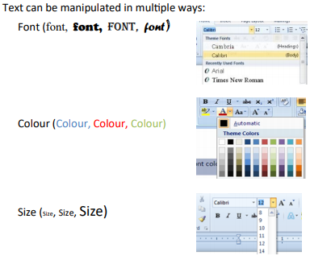
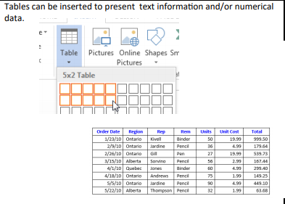
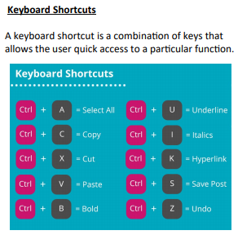
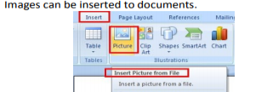
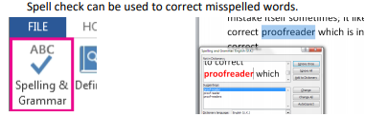
Year 7 Computing Half Term 2
Word Processing

Slide 4

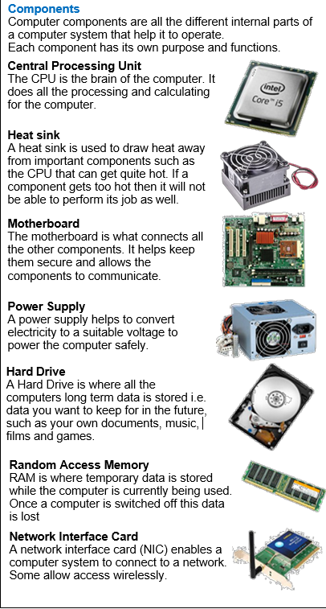
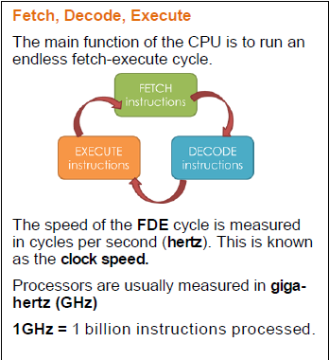
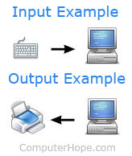

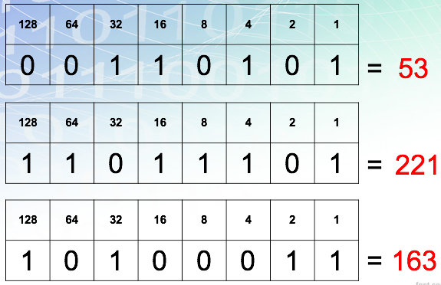
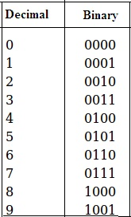
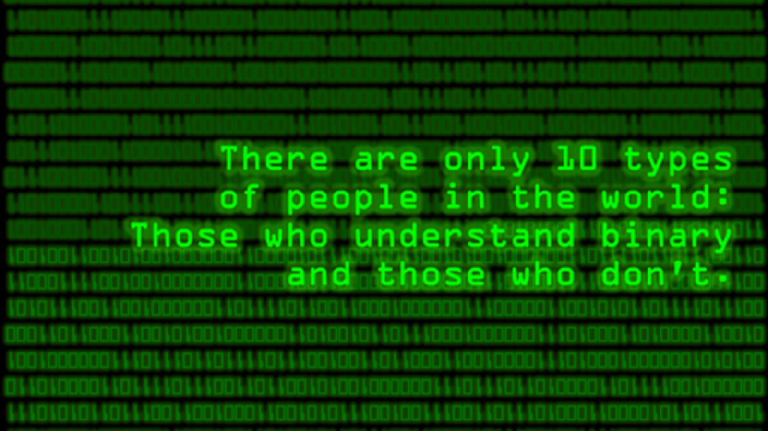
Year 7 Computing Half Term 3
Understanding Computers - Part A
What is a computer?
A computer is any device that takes
an input, processes it and then outputs information
Input Devices
An input device is a piece of hardware that can be
used to enter data into a computer
Output Devices
An output device is a piece of hardware that can be used to represent information in a variety of ways

Slide 5
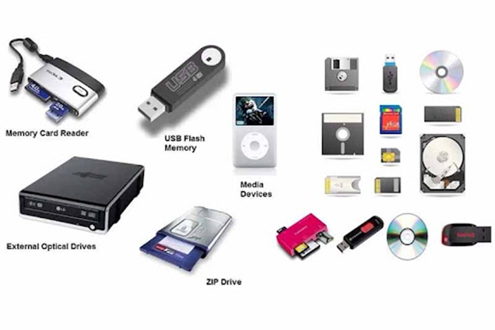
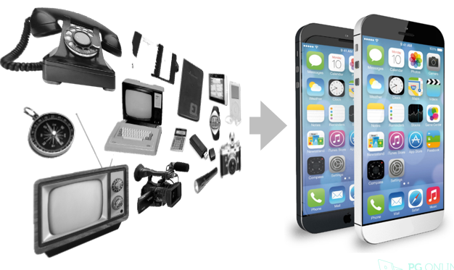
Year 7 Computing Half Term 4
Understanding Computers - Part B
What is a storage device?
A piece of computer equipment on which information can be stored.
Storage Devices
Rules of Binary Addition
0 + 0 = 0
0 + 1 = 1
1 + 1 = 10
1 + 1 + 1 = 11
Convergence
New Technologies
Artificial Intelligence (AI) and Machine Learning (ML)
Quantum Computing.
Virtual Reality (VR) and Augmented Reality (AR)
Internet of Things (IoT)
Robotic Process Automation (RPA)
Blockchain

Slide 6
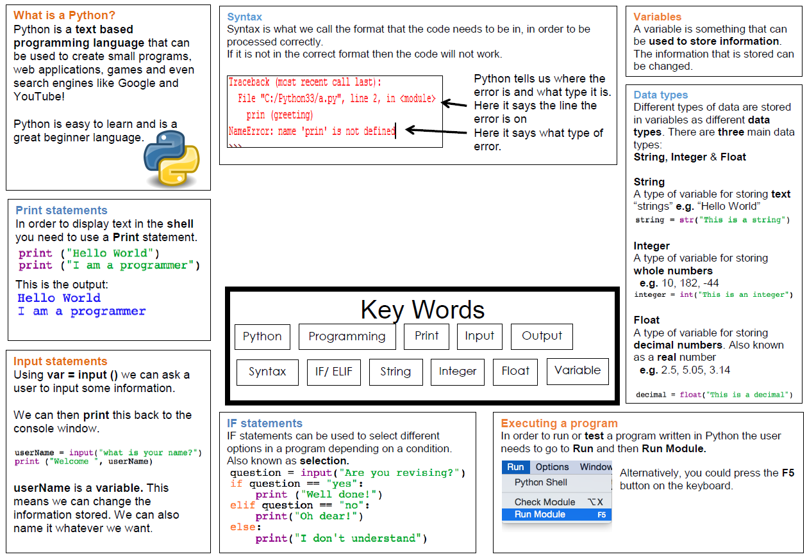

Year 7 Computing Half Term 5
Python

Slide 7

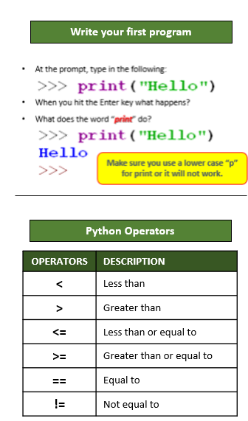
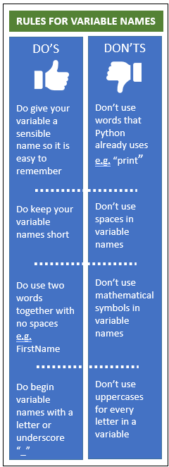
Year 7 Computing Half Term 5
Python key skills
KEYWORDS
Word | Meaning/Description
Python | Python is a text based programming language that allows you to create programs and applications.
Variable | Variables are containers for storing data.
Comments | Programmers used comments to help explain the code. The symbol for comments is #
For loop | A for loop is used to repeatedly execute a set of statements until the end of sequence is reached.
If statement | If statements are used for decision making programs. An if statement will run the code only when the IF condition is true.
Logic errors | Logic Errors occur when the program runs without crashing, but produces an incorrect result. The error is caused by a mistake in the program's logic.
Run time error | It is an error that occurs when the wrong data type is used in a program.

Slide 8
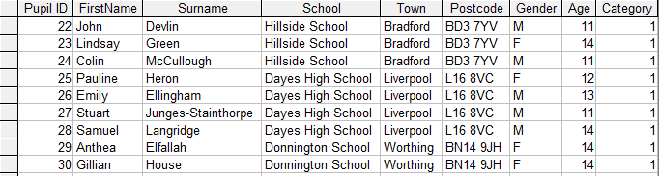
Year 7 Computing Half Term 6
Databases
Database Structure
Key terms
A database contains one or more tables
A database with only one table is called a flat file database
A table has rows, each row containing one record
Columns in the table each contain one field belonging to the records
Term | Definition
Record | All of the data in a row in a table.
Field | The identifier at the top of each column for the data below.
Table | Where multiple records are stored.
Validation | Rules which are used to check that the data entered is correct.
Form | Used to allow a person to interact with a database, usually to input or search for data.
Query | Used to search a database for a certain piece of information.
Primary Key | Each record may have a unique identifier, called the primary key.
Database Structure
Query Operators
Primary Key
Field
Operator | Meaning | Example
< | Less than | <1.65
<= | Less than or equal to | <=40
> | Greater than | >1.9
>= | Greater than or equal to | >=30
= | Equal to | =“M”
BETWEEN | Tests for a range of values | BETWEEN 18 AND 25
OR | At least one of the criteria must be satisfied | “medium” OR “overweight”
NOT | All criteria are satisfied except for the ones specified | NOT “bald”
Record
Table

