Slide 2
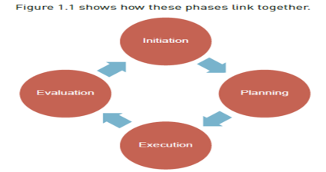
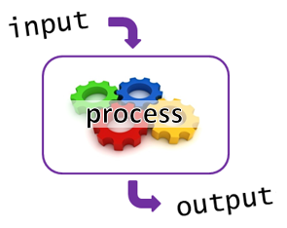

Year 9 Computing Term 1
Mayhem Manor
What is Project Planning?
Setting a goal whereby resources and skills are managed in order to successfully coordinate and complete a project.
Project Life Cycle
Inputs, Processes and Outputs.
For this unit you will take on the role of a project manager for the theme park Mayhem Manor and plan the opening of a new theme park water ride, by following the stages of the project life cycle.
Key words
Inputs
Profit
Mayhem Manor
Input= Data is input into a computer system EG a rollercoaster senses the movement of a carriage on the track.
Process= The system processes the data and handles it the appropriate way. EG The camera is activated
Output= The action is then taken dependent on how the data has been processed. EG A ride photograph is taken
Evaluation
Design
Revenue
Business Calculations
Process
Revenue is the money made from selling products/services. It is calculated using:
Selling Price X Quantity Sold
Profit is the money you have left from your revenue, after your costs have been deducted. It is calculated using:
Total Revenue – Total Costs
Implementation
Sub-task
Costs

Slide 3


Year 9 Computing Term 2
Digital Detectives
Browsers
Key terms
A browser is a piece of software that allows a user to access the internet. Without the browser the user would not be able to use the internet.
There are various types of browsers available and users can choose whichever one suits them best depending on the features they need/want.
Key Term | Definition
Browsers | A piece of software that allows a user to access the internet. An example of this is Safari, Chrome, Edge etc
Accuracy | This refers to how up to date a source of information is. If information hasn’t been updated/isn’t updated regularly it will not be reliable.
Reliability | This refers to how trustworthy and truthful information is.
Advanced Searches | Making use of Boolean terms to ensure you get relevant results when searching for information online.
Photoshop | A piece of software used to manipulate and edit photos/images
Airbrushing | The process of editing an image.
Spot healing brush | A tool in Photoshop that removes blemishes/spots on the skin in photos.
Quick Selection Tool | A tool in Photoshop that allows the user to quickly select parts of a photo
Cloning | A tool in Photoshop that allows the user to select parts of an image, which can then be copied and used elsewhere within the image.
Composition | Where two or more images are combined.
Liquify | A tool in Photoshop where the user can push/pull/smudge pixels within an image. This method quickly distorts images as the pixels are turned to “liquid”
Masking | This allows the user to manipulate layers within an image.
Browsing for information
When looking for information, the user must consider how accurate and how reliable the source is. One way a user can narrow down search results when browsing online is through Advanced searches:
AND | Results must contain both criteria | Harry AND potter which would only return results containing both words.
OR | Results must contain at least one of the search criteria | Harry OR Potter would return all results containing the words either Harry or Potter
NOT | Results must not contain the specified criteria | Harry NOT Potter would only return results containing the word Harry.
Airbrushing
Airbrushing is the manipulation and altering of an image or photo. It is mostly done using a piece of software called Adobe Photoshop.
Benefits | Drawbacks
Helps businesses market their products Can increase self confidence Can remove unwanted parts of photos | Gives people a false image of “perfection” Can be misleading Overused in media to create fake news

Slide 4
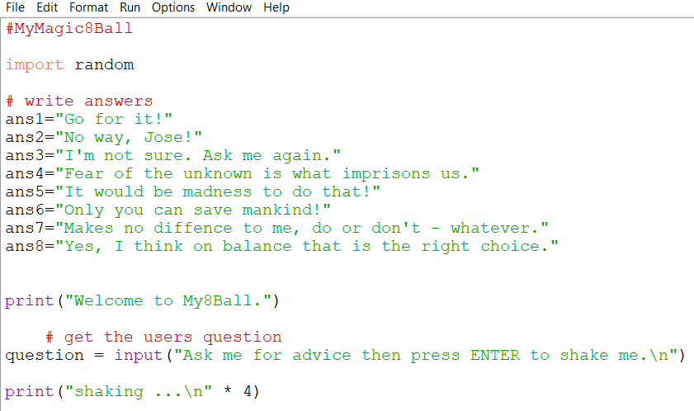

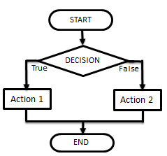
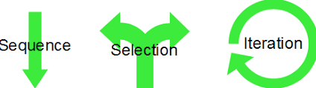
Year 9 Computing Half Term 5
Introduction to Python
Coding in Python
Key terms
Operator/ | Definition
Exponentiation | Raises a number to a power eg: 2**3 OR 2 ^3 (=2³)
DIV | Gives the whole number after a division
MOD | Gives the remainder part of a division
== | Is equal to
! or <> | Is not equal to
< | Is less than
> | Is more than
>= | Is more than or equal to
<= | Is less than or equal to
Flowcharts
Constructs
Flowcharts are methods sets of instructions/ planning represented by shapes within a diagram.
Pseudocode is fake code used a planning tool prior to developing code within a developer.
A Sequence is when there are programming steps that are carried out one after another.
Selection is where there are different paths in your code eg: IF, ELIF, ELSE
Iteration is when there is repetition (loops) in code. This could be a WHILE loop (do something WHILE a condition is met) or a FOR loop (do something for a set number of times)

Slide 5

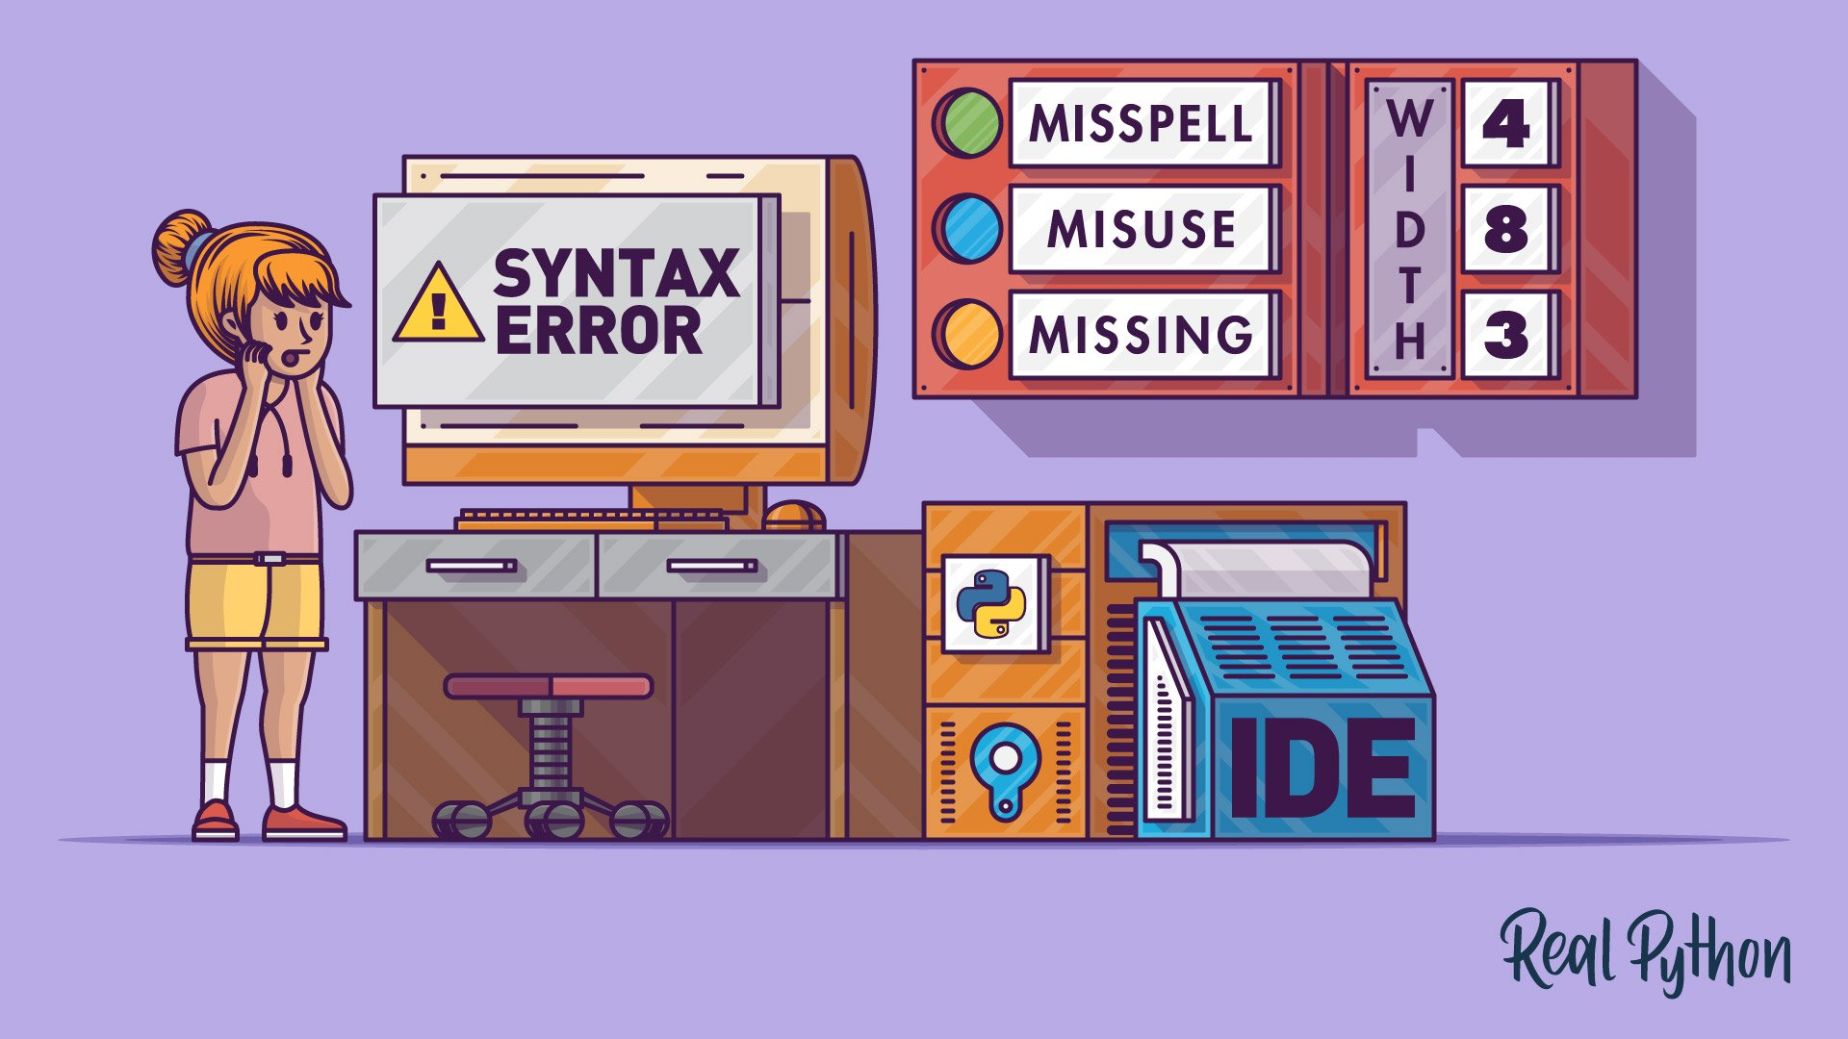
Year 9 Computing Half Term 6
Introduction to Python
Programming
Key terms
Programming is a set of instructions a computer uses to work and run correctly and efficiently. Without Programming most technology wouldn’t exist!
Python is a high level programming language
We are going to continue using an IDE to write and produce code in IT this term.
IDE | Integrated development environment
Debugging | Getting rid of an error within a programme.
Algorithm | A method of planning a programme either using Pseudocode or a flowchart.
Flowchart | A combination of shapes and arrows to demonstrate a process within a programme
Pseudocode | A planning method used to write code where both English and short script code is used. It is basically “fake code”
While Loop | A programme that repeats while the condition being tested is true.
Iteration | Where something repeats several times. This occurs within a loop.
Syntax error | The most common error in python where the programme doesn’t understand the code and can therefore not run it.
Logic Error | Logic errors in a program are mistakes in the algorithm you have devised to perform the required task
Counter | Counter variable to say how many times the user attempted the question
Compiler | A compiler or interpreter to translate your program into machine code
Error diagnostics | Used to point out syntax errors
Searching | A process used in python to find a specific piece of data.
Sorting | Where you organise data in a way that allows the user to search/find information easier.
Data Types
Data Type | Definition
String | Text eg: “Hello”
Integer | Whole number eg: 32
Float/Real | Decimal number eg: 1.2
Boolean | Two values eg: true or false
Character | A single character eg: b
Debugging
If you have a syntax error look for errors in your:
Spelling
Punctuation
Capitals
Indentation
Use of functions

