Slide 2
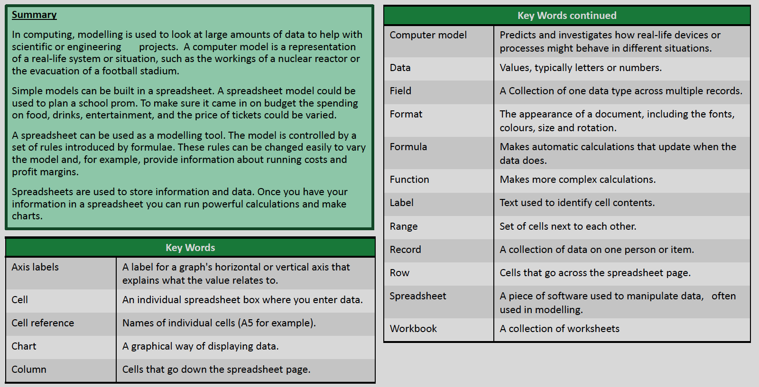
Year 10 IT Half Term 1

Slide 3
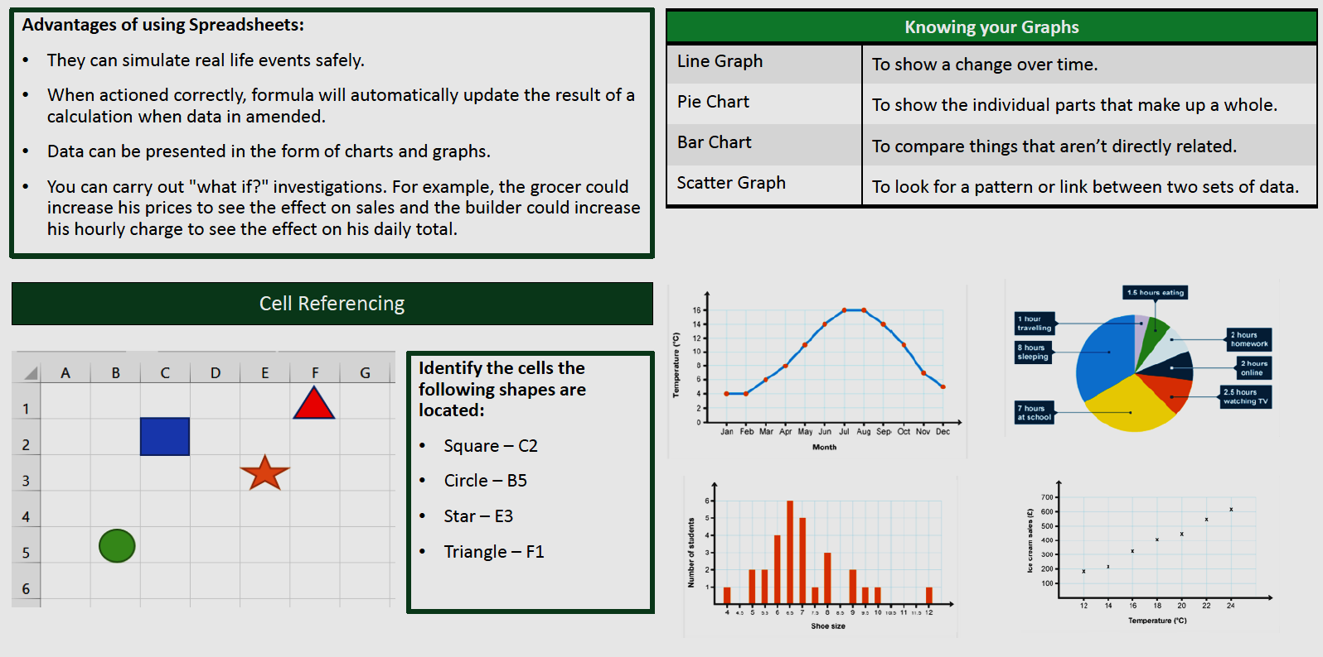
Year 10 IT Half Term 2

Slide 4
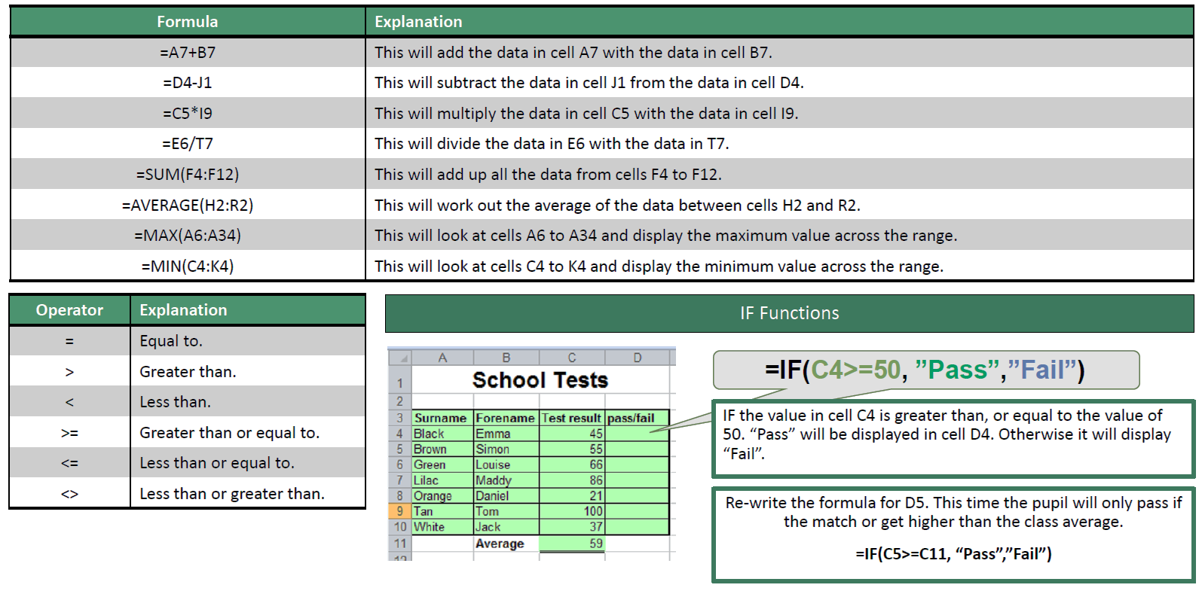
Year 10 IT Half Term 3
Creating a model and manipulating data

Slide 5
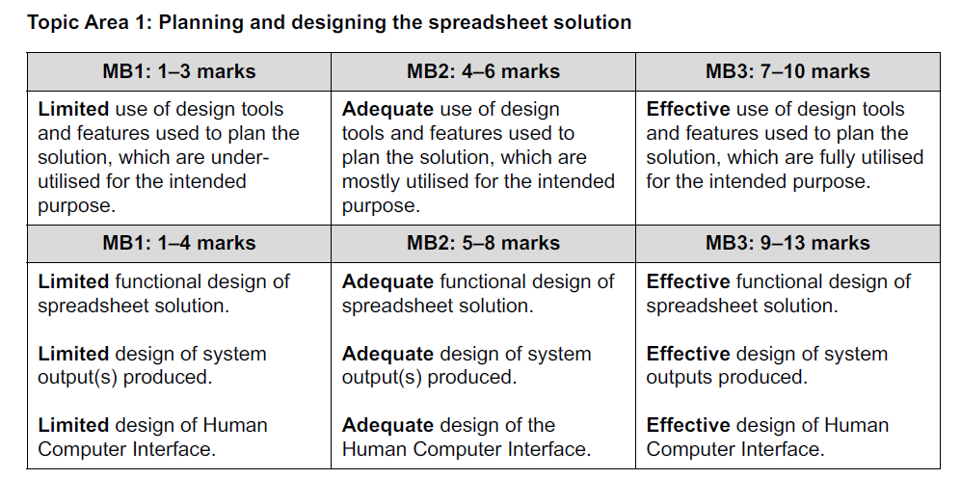
Year 10 IT Half Term 4
Creating a solution for a client

Slide 6
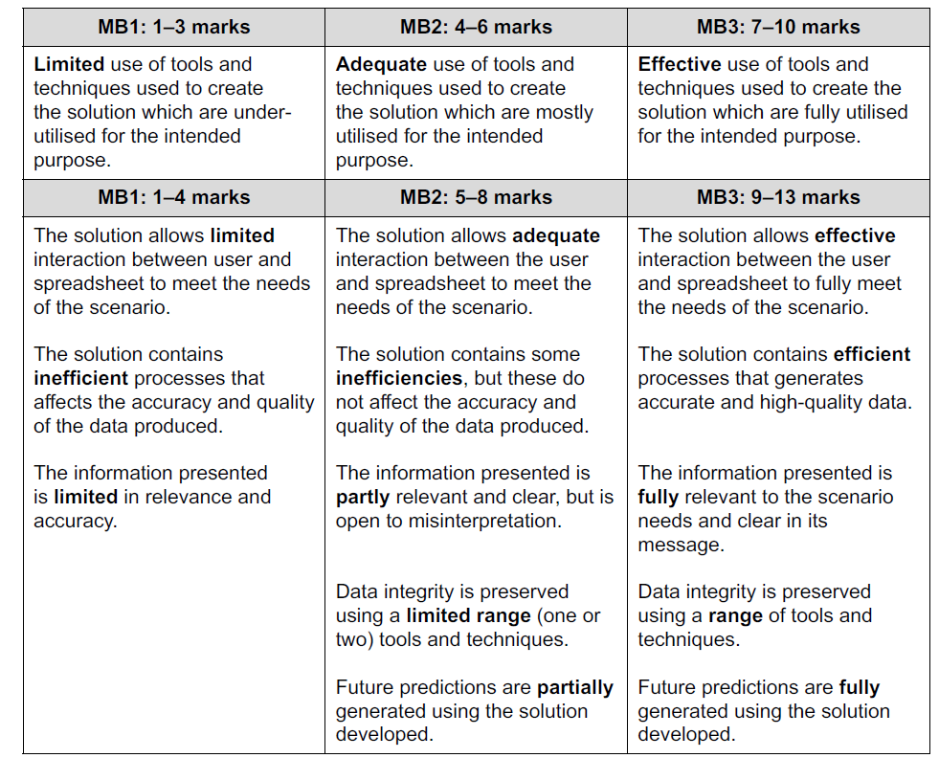
Year 10 IT Half Term 4
Creating a solution for a client

Slide 7
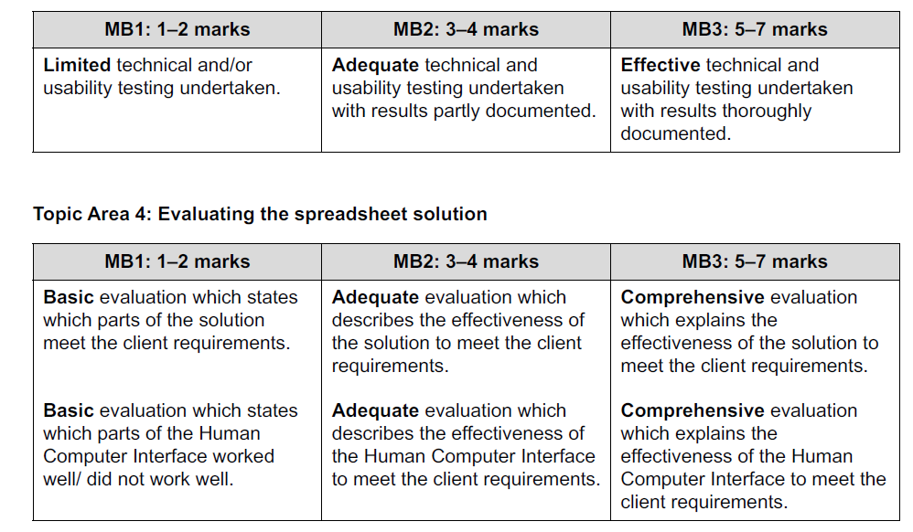
Year 10 IT Half Term 4-6
Creating a solution for a client

Slide 8


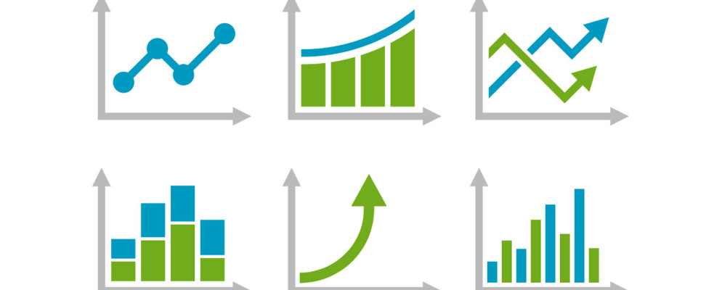
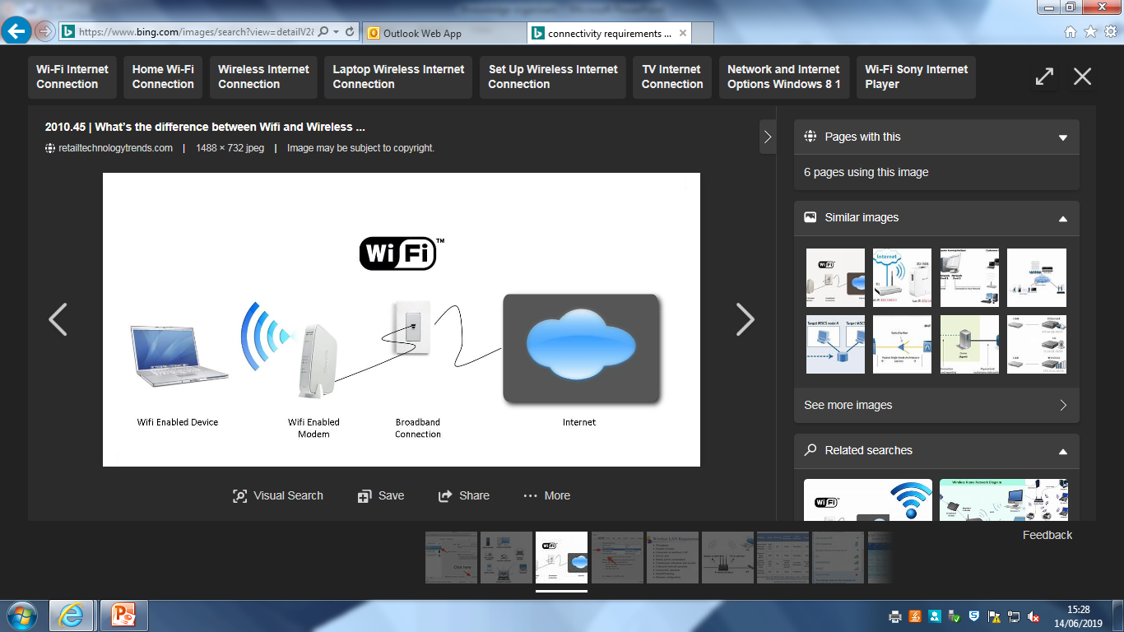
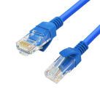

Year 11 IT
Understand the different methods of processing data and presenting information
6.1 Selection and justification of the appropriate software tools and techniques to process data to meet the defined objectives in a given context.
When data has been collected, it needs to be processed. There are two main tools that can be used to process data. These are:
Spread sheets- formula, worksheet, referencing, macros
Databases- tables, records, queries, validation, reports
6.2 Selection and justification of the appropriate tools and techniques to present information, including the purpose and suitability and the advantages and disadvantages.
When data has been stored and processed, the results have to be presented. Which tool is used to present the information will depend on:
What information is to be presented
How it is to be presented
The objectives defined in the project life cycle
Other methods to present data/ information are:
Word processing
Desktop publishing
Power point presentation
Considerations also need to be made regarding:
The target audience
Content limitations
The availability of information
The impact of distributing the information
The distribution channel- Messaging services, Websites, VoIP, Multimedia, Cloud-based and Mobile apps
The presentation methods- Report, Presentation, Charts, Tables, Integrated document and End-user documentation
6.3 The resources required for presenting information
Hardware requirements
Software requirements
Connectivity requirements
Consideration of the user’s requirements and your audience

Slide 9
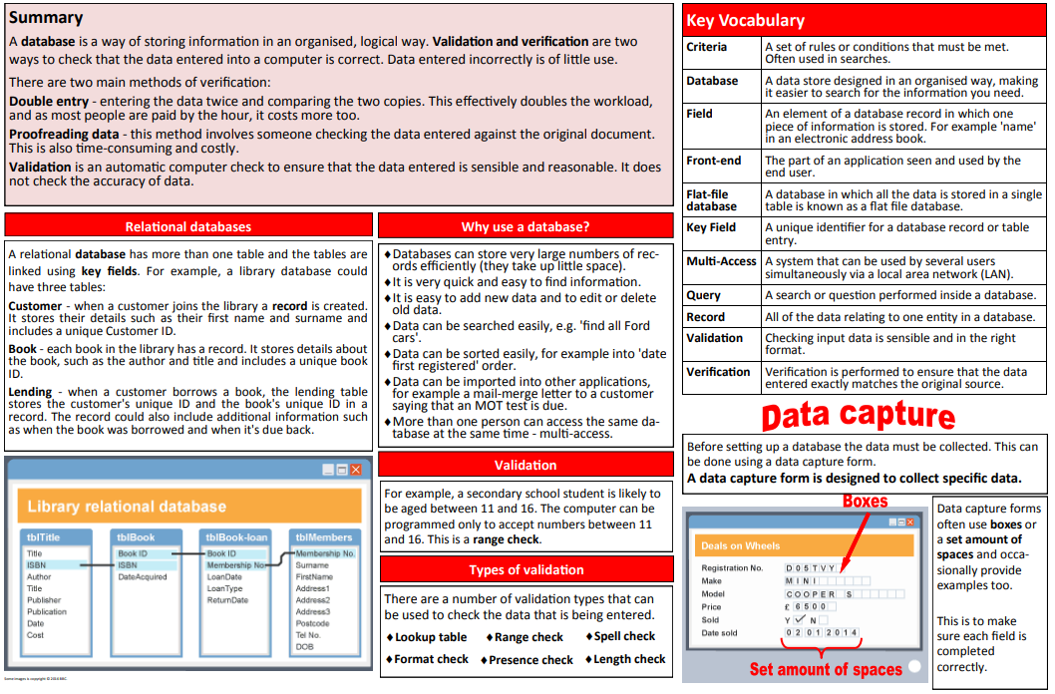
Year 11 IT Coursework Support
To be able to import and manipulate data to develop a solution to meet an individual need

Slide 10
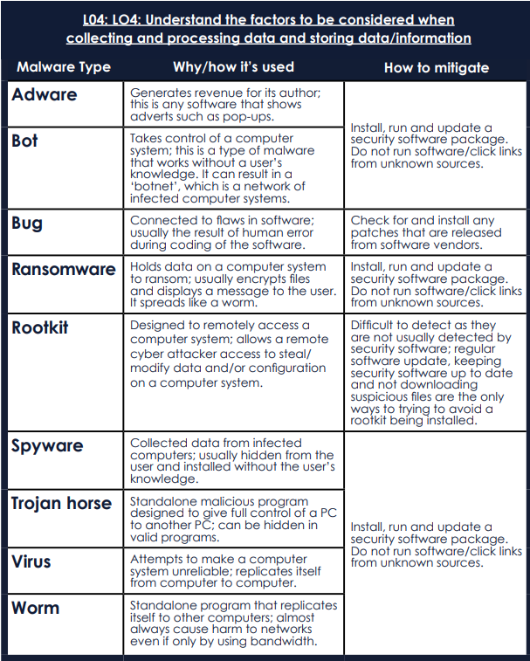
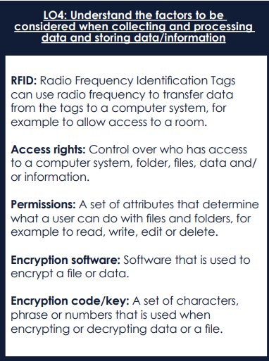

Year 11 IT Theory 1

Slide 11
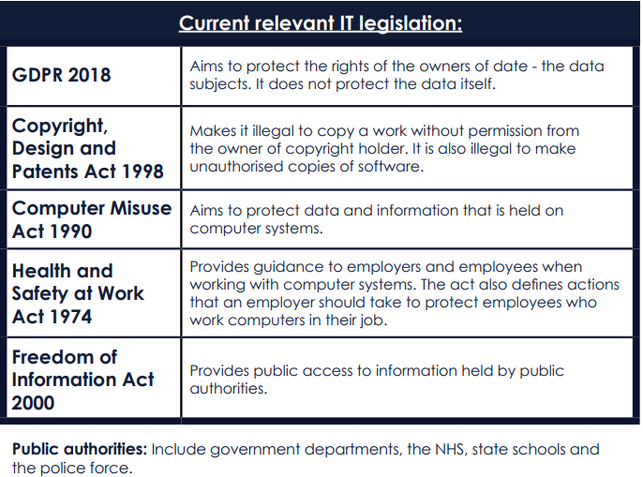
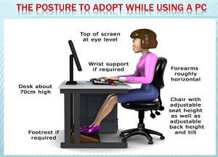

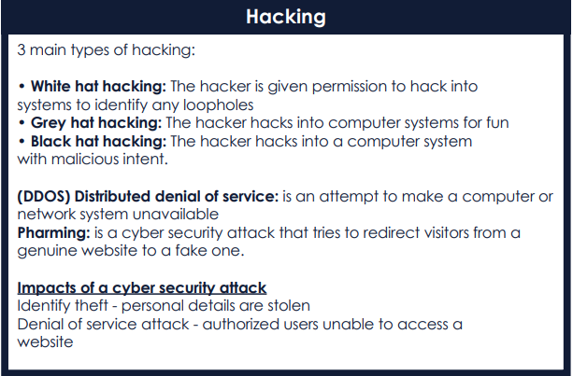


Year 11 IT Theory 2

Slide 12
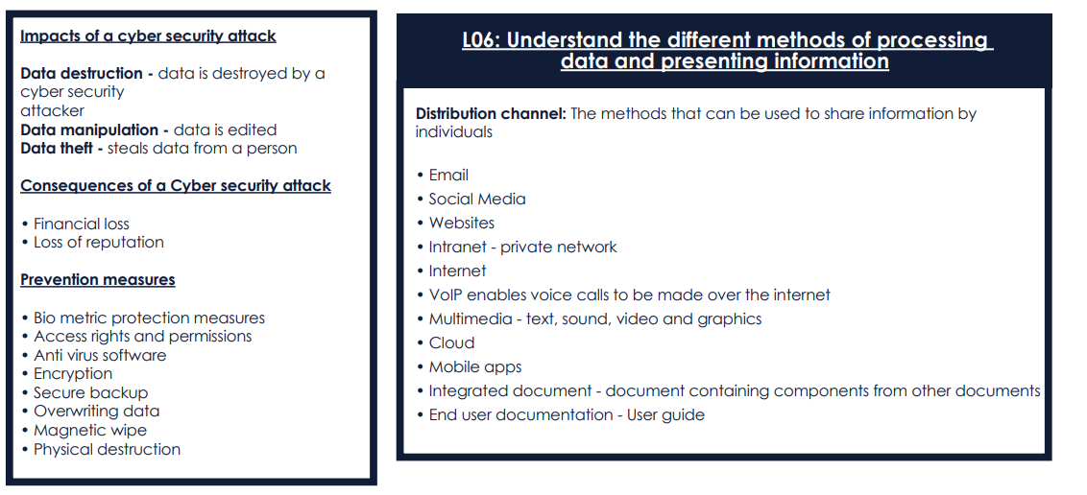



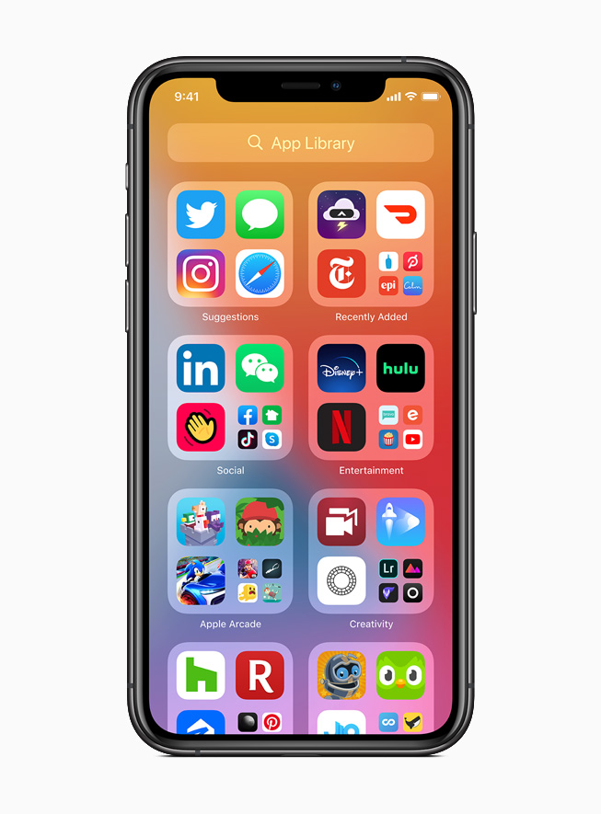


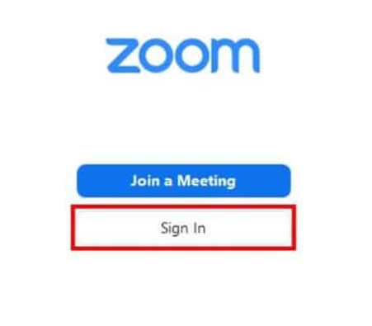

Year 11 IT Theory 3

