Slide 1



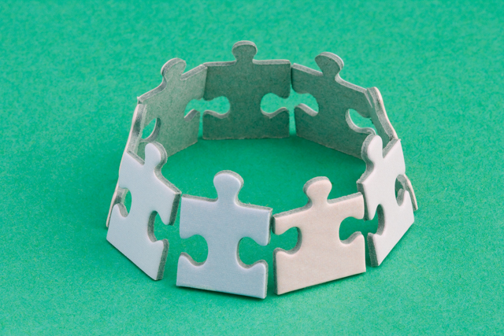
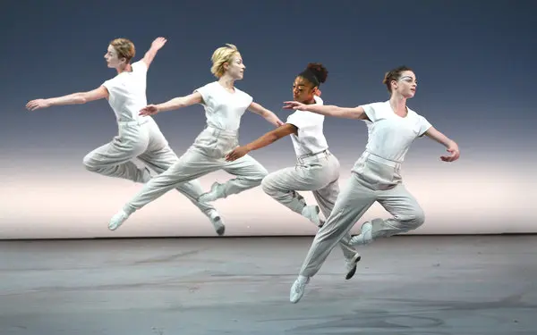
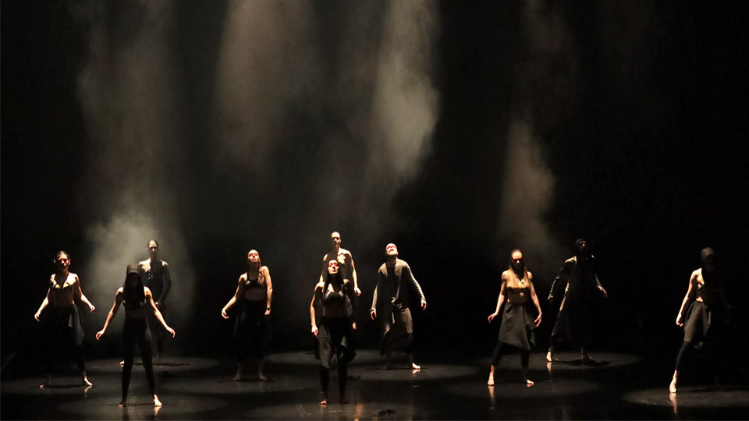
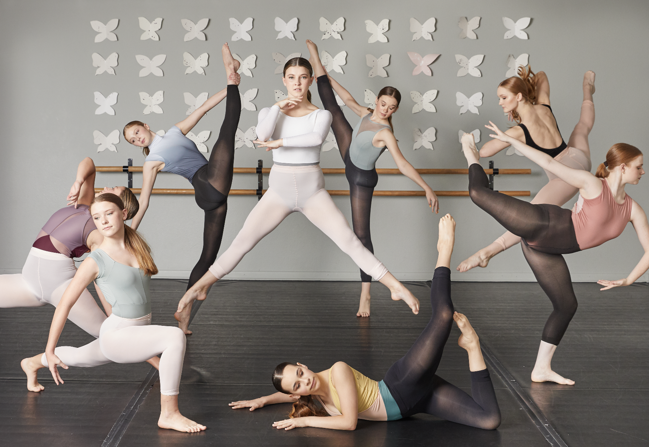
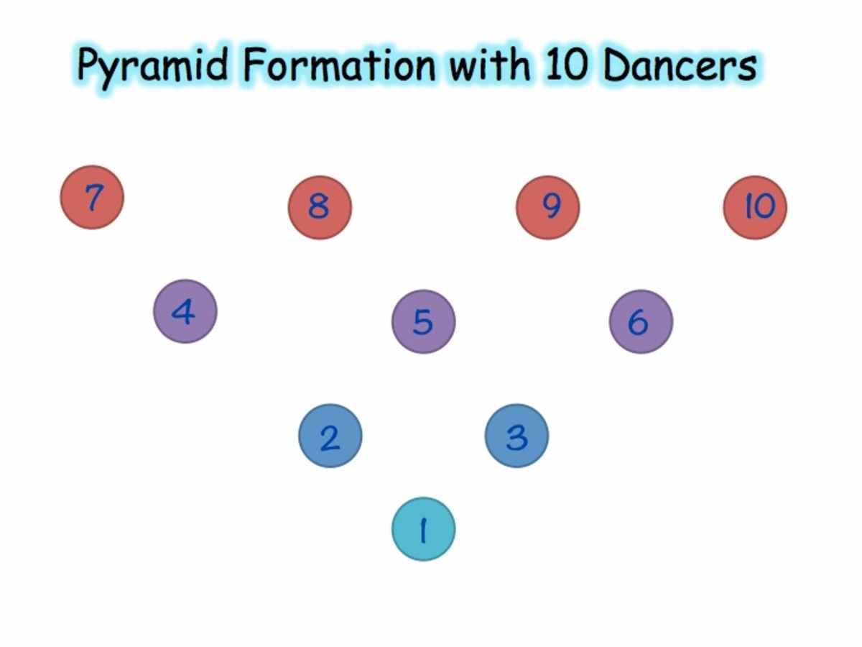
6 Basic dance actions - Jump, stillness, gesture, fall, turn, travel.
Unison: performing the same movement at the same time
Performance: the sum of all the elements that come together in the act of dancing.
Choreography: create a dance.
Canon: when the same movements overlap in time.
Transition: Links between phrases or sections in a dance
Formation
Levels

