Slide 1
YEAR 8 DRAMA KNOWLEDGE ORGANISER
HT1 – Darkwood Manor
Subject Terminology:
Atmosphere | The atmosphere is the mood of feeling of a scene. For example, tense, scary, light, happy.
Tension | Tension is the word to describe the feeling that something is about to happen.
Pace | The speed at which someone speaks.
Pitch | Speaking in a high, low or natural voice.
Tone | Tone of voice is its 'colour' or emotional quality. You must make sure that your tone of voice matches the character's mood and what you need to communicate about their feelings.
Corpsing | Where an actor breaks character. This is considered very unprofessional.
Dramatic Techniques:
Soundscape | A soundscape is a series of sounds created by actors (not words, echoes, repetition, or speaking together) that create a setting or suggest a scene. Sounds could range from wind, to creaking boards, to laughter.
Thought-Tracking | A thought-track is when a character steps out of a scene to address the audience about how they're feeling. Sometimes the character might feel something different to the words they're speaking.
Narration | Narrating is adding a spoken commentary for the audience about the action onstage. A narrator is like a storyteller informing the audience about the plot. Narration is useful in making a story more
Hot-Seating | Hot Seating is a Drama strategy that helps actors to develop their knowledge of their character. Questions are asked to the actor sitting in the 'hot-seat' who answers in character. They can use their imagination to answer the questions if they do not already know the answer.
Choral Speaking | Speaking as a group and in unison (all together)

Slide 2
YEAR 8 DRAMA KNOWLEDGE ORGANISER
HT2 – Aliens
Acting Techniques: | Definition: | Subject Terminology & Key Vocabulary: | Definition:
Flashback | Flashbacks interrupt the chronological order of the main narrative to take an audience back in time to the past events in a character's life. | Empathy | The ability to understand and share the feelings of another. (To put yourself in someone else’s shoes)
Role Play | This is the act of pretending to be somebody else, of taking on a role. The role may be from a script or a character you have created. | Humanitarian | A person who seeks to promote human welfare.
Audience Participation | When the audience interacts with the performers in some way or other. | Refugee | A person who has been forced to leave their country in order to escape war, persecution, or natural disaster.
Polished Improvisation | Polished improvisation in theatre is the playing of dramatic scenes without written dialogue but with some planning and rehearsal beforehand. | Oppression | Oppression is the cruel or unfair treatment of a group of people.
Forum Theatre:
Forum Theatre is a technique by Brazilian Director, Augusto Boal. Forum Theatre is a fully interactive performance followed by a safe group dynamic in which the people in the audience have the chance to get up on stage and solve some of the problems the characters face. The show triggers a frank discussion with particular emphasis on the emotions involved on both sides of a dilemma. In the first instance, the actors dramatise the short play, which usually incorporates some kind of oppression. The play is then performed for a second time and, during the replay, any member of the audience is invited to shout “Stop!” when they want to suggest a solution to a specific conflict. Rather than simply offering suggestions from the sidelines, they will need to come up on stage to play it out for themselves. The ultimate aim of Forum Theatre is to trigger discussion and prompt the audience to analyse and to discuss the issues affecting the characters and their community.
Refugees:
More than 70 million people around the world had to leave their homes because of war, persecution or conflict in 2018, according to new figures. The aid organisation UNHCR - which is the United Nation's (UN's) Refugee Agency - says the number is the highest that the organisation has seen in its almost 70-year history, and 2.3 million higher than the year before. There are many reasons that people might have to leave their homes - for example, conflict, famine, natural disasters (like an earthquake or tsunami), or being persecuted or ill-treated because of who they are. The 70 million people who had to leave their homes last year are divided into three groups - refugees, asylum seekers and internally displaced people. The number is equal to about 25 people forced to leave their lives behind every minute.

Slide 3
Y8 Drama - Joyriding – HT3 – Knowledge Organiser |  | Poetry Stimulus: The identification By Roger McGough So you think its Stephen? Then I'd best make sure be on the safe side as it were. Ah, there’s been a mistake. The hair you see, it’s black, now Stephens fair ... What’s that? The explosion? Of course, burnt black. Silly of me. I should have known. Then let’s get on. The face, is that the face mask? That mask of charred wood blistered scarred could that have been a child's face? The sweater, where intact, looks in fact all too familiar. But one must be sure. The scout belt. Yes that’s his. I recognise the studs he hammered in not a week ago. At the age when boys get clothes-conscious now you know. It’s almost certainly Stephen. But one must be sure. Remove all trace of doubt. Pull out every splinter of hope.
Key Techniques: Thought-Tracking: when a character speaks their thoughts aloud to the audience (no other character on stage can hear this.) Physical Theatre: Using your body to tell a story rather than words/ Creating objects on stage using your body Hot Seating: a drama strategy in which a character or characters, played by the teacher or a child, are interviewed by the rest of the group. Split Scene: When two or more scenes are played on stage at the same time on stage. Each scene may freeze and un-freeze to allow the other to be heard. | Key Vocabulary: Sub-text: The hidden meaning behind the words a character says Opinion: a view or judgement formed about something, not necessarily based on fact or knowledge. Poem: a piece of writing in which the expression of feelings and ideas is given intensity by particular attention to diction (sometimes involving rhyme), rhythm, and imagery. Tableaux: A still image - a group of actors or motionless figures representing a scene from a story Forum: a meeting or medium where ideas and views on a particular issue can be exchanged. Flashbacks: a scene that takes place before a story begins that takes the audience back in time to the past events in a character's life.
News Report Stimulus: 17:53 8 Apr 2019 (Liverpool Echo) A joyrider tanked up on booze killed his friend after speeding away from police in a stolen car. Joseph Lane, 27, would "never forgive himself" for the fatal crash, a court was told. The 27-year-old and his passenger Brandon Griffin were flung through the windscreen of the Vauxhall Vectra after Lane lost control and smashed into a telegraph pole, flipping onto its roof, reports the Liverpool Echo. Mr Griffin, 21, is believed to have been involved in the theft of the car from a driveway in Birkenhead the same morning and had offered Lane a chance to drive it only minutes before the devastating collision. Lane, of Tranmere, was jailed for eight and a half years at Liverpool Crown Court today after admitting causing Mr Griffin's death by dangerous driving.
Pockets. Empty the pockets.
Handkerchief? Could be any schoolboy's.
Dirty enough. Cigarettes?
Oh this can't be Stephen.
I don’t allow him to smoke you see.
He wouldn't disobey me. Not his father.
But that's his penknife. That’s his alright.
And that’s his key on the key ring
Gran gave him just the other night.
Then this must be him.
I think I know what happened
... about the cigarettes
No doubt he was minding them
for one of the older boys.
Yes that’s it.
That’s him.
That’s our Stephen.
Joyriding: the action or practice of driving fast and dangerously in a stolen car for enjoyment.
The sentence for people convicted of aggravated car theft or joyriding is severe and includes long prison terms and large fines. A prison term of up to 13 years may be imposed if the theft and subsequent driving led to a death. (May 2021)

Slide 4
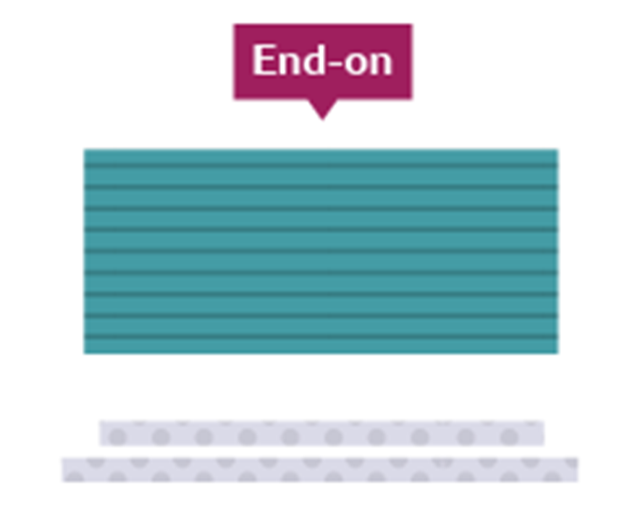
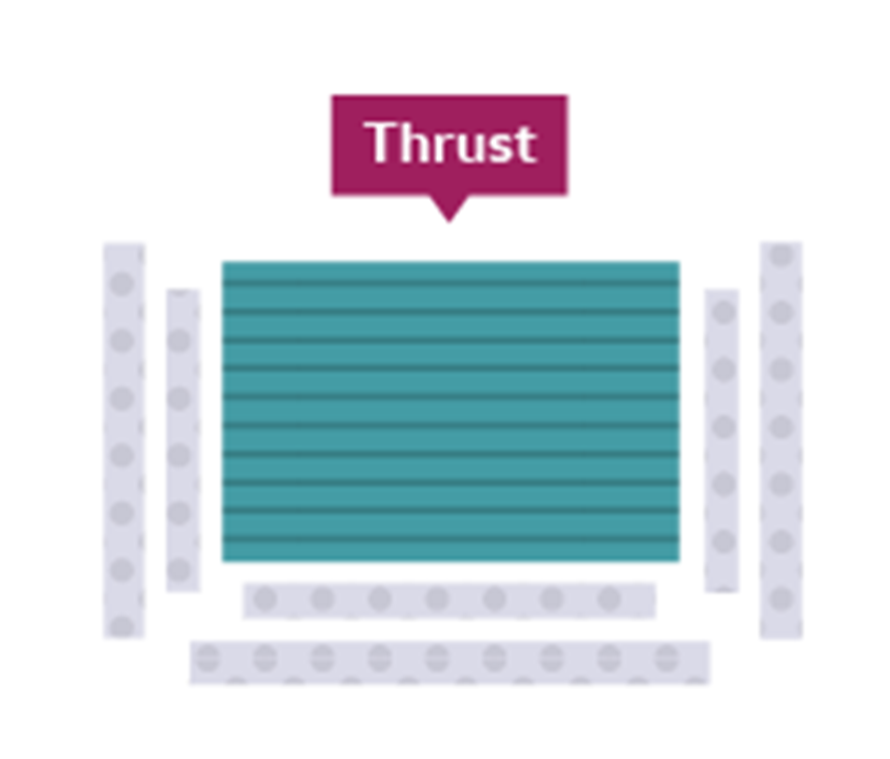


Y8 Drama – Melodrama & Soap Opera – HT4 – Knowledge Organiser |  | Stage types:
Melodrama: Melodrama is a style of theatre that was prominent in the Victorian era. It uses exaggeration and stereotyped characters to appeal to the audience’s emotions. It can be useful when working within the melodrama genre to explore stock characters, e.g. an evil villain, a wronged maiden or a noble hero. Very clear and loud vocal delivery is needed in a melodrama, facing out to the audience, combined with large gestures and exaggerated facial expressions. The plot for a melodramatic devised piece would ideally be very sensational, designed to evoke emotion within the audience, with lots of dialogue. | Soap Opera: A soap opera or soap for short is a radio or television serial dealing especially with domestic situations and frequently characterised by melodrama, ensemble casts, and sentimentality. The term "soap opera" originated from radio dramas originally being sponsored by soap manufacturers. Soap opera storylines run concurrently, intersect and lead into further developments. An individual episode of a soap opera will generally switch between several narrative threads that may at times interconnect and affect one another or may run entirely independent to each other. Episodes may feature some of the show's current storylines, but not always all of them. Soap operas rarely bring all the current storylines to a conclusion at the same time. When one storyline ends, there are several other story threads at differing stages of development. Soap opera episodes typically end on some sort of cliff-hanger.
Key Techniques / Vocabulary: Exaggeration: Exaggeration is the representation of something as more extreme or dramatic than it really is. Exaggeration is used to emphasise certain ideas by overstating it in some way. This can add drama, suspense, humour, etc. for the audience. Stereotype: A familiar character identified by an oversimplified pattern of behaviour that typically labels the character as being part of a group of people. Stock Characters: Stock characters are characters that are specific to a particular style of theatre. | Key Techniques / Vocabulary: Cliff-hanger: A cliff-hanger is a plot device in fiction which features a main character in a precarious or difficult dilemma or confronted with a shocking revelation at the end of an episode of serialised fiction. Flash Forward: A flash forward is a scene that temporarily takes the narrative forward in time from the current point of the story. Flash forwards are often used to represent events expected, projected, or imagined to occur in the future. Flashback: a short part of a film, story, or play that goes back to events in the past.
Remember:
When blocking your performances, you must be mindful never to show your back to the audience for longer than necessary.
Before you begin your rehearsal, pick and agree on where your audience will be.
Use diagonal positioning when speaking to another character on stage so that the audience can still see your facial expressions clearly.
Aim to face the audience as much as possible – this means that the audience gets the most out of your vocal projection and will be able to hear you clearly at all times.

Slide 5
Y8 Drama – Greek theatre & Antigone – HT5 & 6 – Knowledge Organiser | Antigone - Plot: Two brothers, Polyneices and Eteocles are each leading opposing sides. Eteocles is fighting for the current King – King Creon, and Polyneices is fighting to overthrow King Creon. Before the play begins we learn that the brothers are both killed in battle, and so the civil war comes to an end. King Creon orders that Eteocles will be honoured and given a royal burial, but Polyneices will be disgraced. His body will be left to rot outside the battlements for the animals to pick apart and anybody who attempts to bury him will also be put to death. Antigone and Ismene are the sisters of Polyneices and Eteocles. Antigone brings Ismene out of the city walls at night for a secret meeting. Antigone is devastated and desperate to bury Polyneices’ body and wants Ismene to help her. Ismene refuses. She is too scared of the death penalty, the girls argue but Ismene is unable to talk Antigone out of her decision to bury Polyneices. The next night, Antigone sneaks out of the city walls. She waits until the guards guarding Polyneices’ body fall asleep, drags the body a short distance away and buries it. In the morning, the guards discover the body has gone missing. They are all scared, and argue over who should tell King Creon. Creon is raging. He suspects Antigone and orders the guards to bring her to the throne room. Creon questions Antigone, who does not deny burying her brother. Instead she openly argues with King Creon over the decision. Antigone argues that without burial her brother would never have been able to reach the afterlife. King Creon suspects that Antigone could not have buried her brother on her own and thinks Ismene must have helped her. He orders the guards to bring Ismene. Ismene, wanting to die alongside her sister, falsely confesses to the crime but Antigone will have none of it. The sisters argue again over who was involved in burying the body. Creon – confused over the argument, orders that both girls be put into jail for the time being. Creon’s son Haemon enters. He is engaged to Antigone and wants to convince his father to spare her life. Father and son argue, but Haemon cannot change the fact that Antigone will face the death penalty. Haemon leaves, and vows never to see or speak to his father again. Creon decides to spare Ismene and to imprison Antigone in a cave – without food or water they will brick up the mouth of the cave so that Antigone has a slow and painful death. She is brought out of the house, and she defends her actions one last time. She is taken away, with the Chorus expressing great sorrow for what is going to happen to her. Tiresias, the blind prophet, enters. He warns Creon that the Gods side with Antigone. Creon accuses Tiresias of being corrupt, and Tiresias responds that because of Creon's mistakes, he will lose one child for the crimes of leaving Polyneices unburied and putting Antigone into the earth. All of Greece will despise him, and the sacrificial offerings of Thebes will not be accepted by the gods. The Chorus, terrified, asks Creon to take their advice. He starts to waiver, and they tell him that he should bury Polyneices and free Antigone. Creon, shaken, agrees to do it. Creon leaves with his guards to help him right his previous mistakes but a Messenger enters to tell them that Haemon has killed himself. Eurydice, Creon's wife and Haemon's mother, enters and asks the Messenger to tell her everything. The Messenger reports that Haemon and Antigone have both taken their own lives. Eurydice disappears into the palace. Creon understands that his own actions have caused these events. A Second Messenger arrives to tell Creon and the Chorus that Eurydice has killed herself. With her last breath, she cursed her husband. Creon blames himself for everything that has happened, and, a broken man, he asks his servants to help him inside. The order he valued so much has been protected, and he is still the king, but he has acted against the gods and lost his child and his wife as a result. The Chorus closes by saying that although the gods punish the proud, punishment brings wisdom.
Greek Theatre: Theatre was a very big focus in Greece and started in approximately 550 BC. Theatre performances were in honour of an ancient Greek God called Dionysus. They had big festivals and theatre competitions in honour of this Greek God – Dionysus. There were three types of theatre; Comedy, Tragedy and Satire (making fun of leaders). Actors used masks and gestures to tell the story and the chorus (group of singers) told the story like narrators. Sophocles & Antigone: Antigone is a tragedy by Sophocles written in or before 441 BC. Sophocles is one of three ancient Greek tragedians whose plays have survived. The most famous tragedies of Sophocles feature Oedipus and Antigone: they are generally known as the Theban plays. Of the three Theban plays Antigone is the third in order of the events depicted in the plays, but it is the first that was written. Sophocles wrote over 120 plays, but only seven have survived. Antigone is still a popular story today with many adaptations in film, theatre and opera.
Key Techniques / Vocabulary: Exaggeration: Exaggeration is the representation of something as more extreme or dramatic than it really is. Exaggeration is used to emphasise certain ideas by overstating it in some way. This can add drama, suspense, humour, etc. for the audience. Canon: moving or speaking one after the other like a Mexican wave Unison: moving or speaking at the same time Hot Seating: Hot Seating is a Drama strategy which helps actors to develop their knowledge of their character. Questions are asked to the actor sitting in the 'hot-seat' who answers in character. Tragedy: Tragedy is a genre of drama based on human suffering and, mainly, the terrible or sorrowful events that befall a main character. Chorus: The chorus (group of singers) stood at the side of the stage and told the story like narrators. Part of the purpose of the Greek Chorus – whilst moving in unison –was to show the emotion of a play’s story with their gestures and facial expression.

