Slide 1

Year 7 Half Term 1
Physical Education

Slide 2
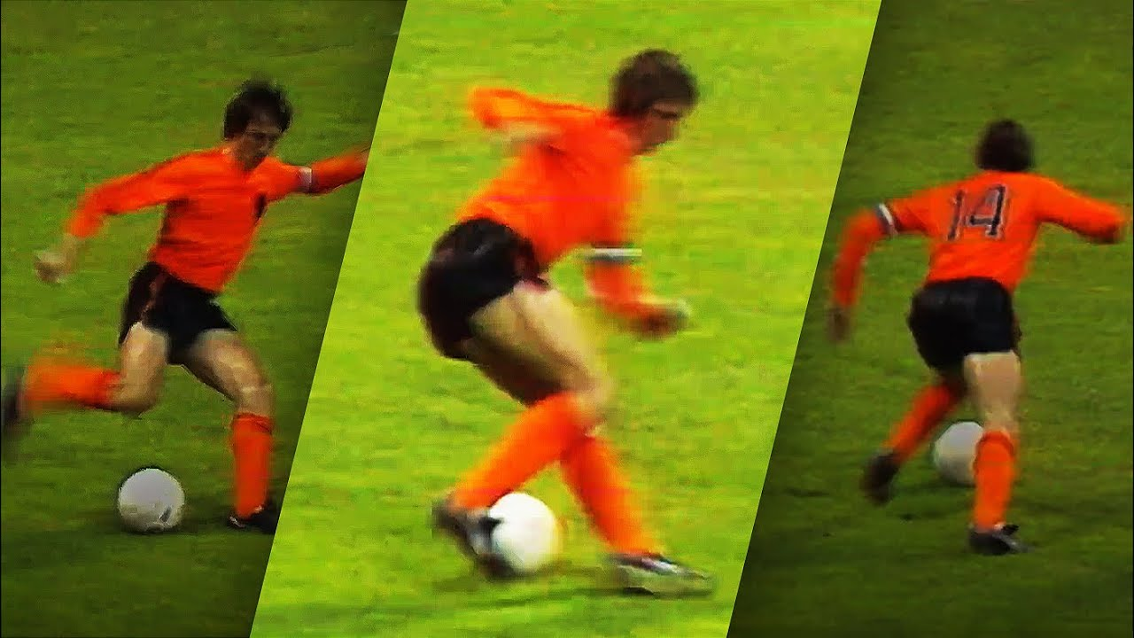
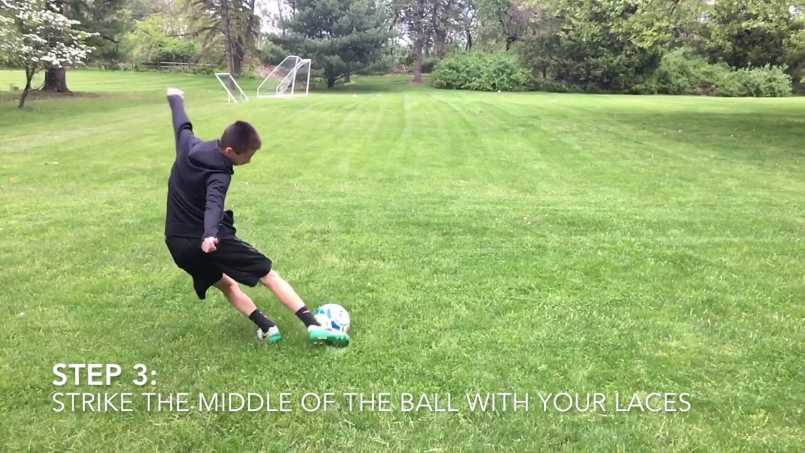
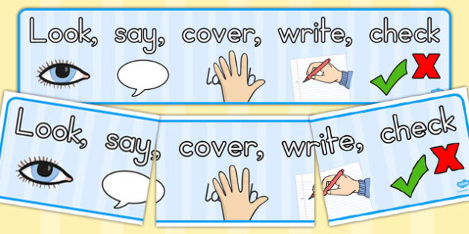
Subject Knowledge Organiser
Football
Subject Knowledge
Passing: The aim of passing is to keep possession of the ball with your teammates. You can conduct this through executing a short pass, driven pass, and/or a lofted pass.
Turning Principles: Within a game scenario, there are opportunities to turn with the ball through executing the Cruyff Turn, drag back, inside toe-loop and/or outside toe-loop.
Key Terminology
Instep
Outside of the foot
Balance
Flexibility
Driven pass
Short pass
Lofted pass
Awareness
Tactics
How can I move the ball quickly within a game scenario?
Why would I turn with the football in a game scenario?.

Slide 3
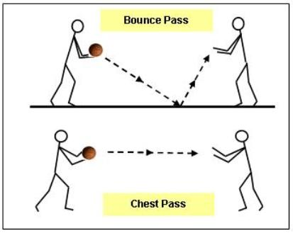
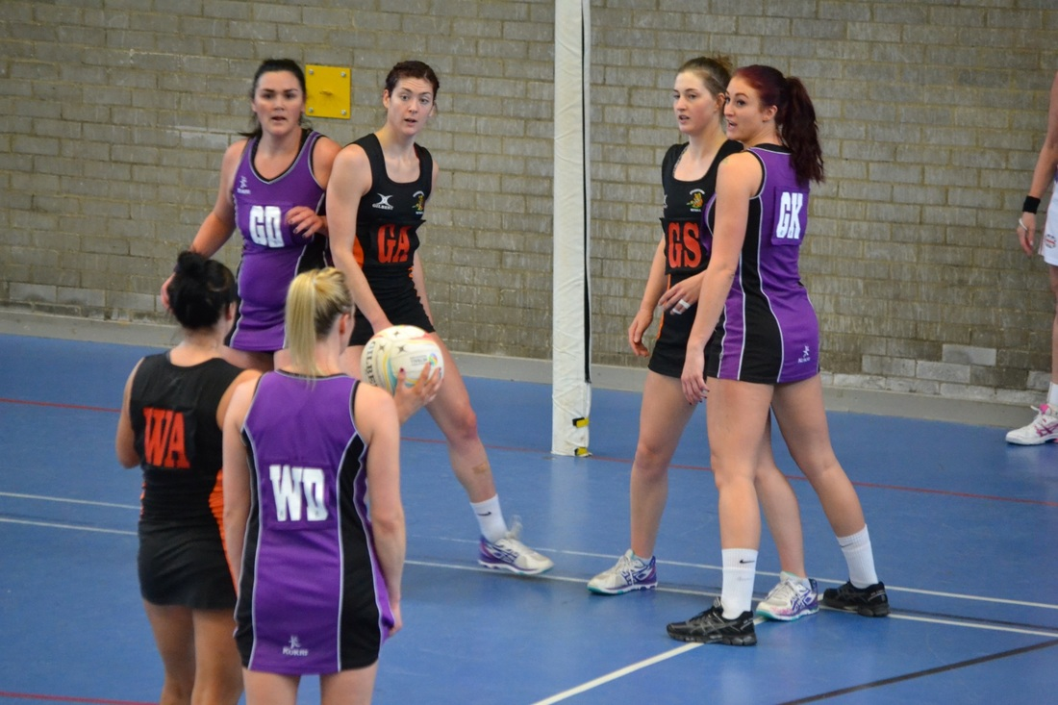
Subject Knowledge Organiser
Netball
Subject Knowledge
Passing: The aim of passing is to keep possession of the ball with your teammates. You can conduct this through executing a bounce pass, chest pass, and/or a shoulder pass.
1st stage of defense: This defensive principle outlines the man to man marking which occurs within the game. This principle outlines how to mark a specific player on court.
Key Terminology
Awareness
Communication
Speed
Pace
Trajectory
Accuracy
Flexibility
Precision
Tactics
How can I move the ball quickly within a game scenario?
When would I use man to man marking in a game scenario?

Slide 4

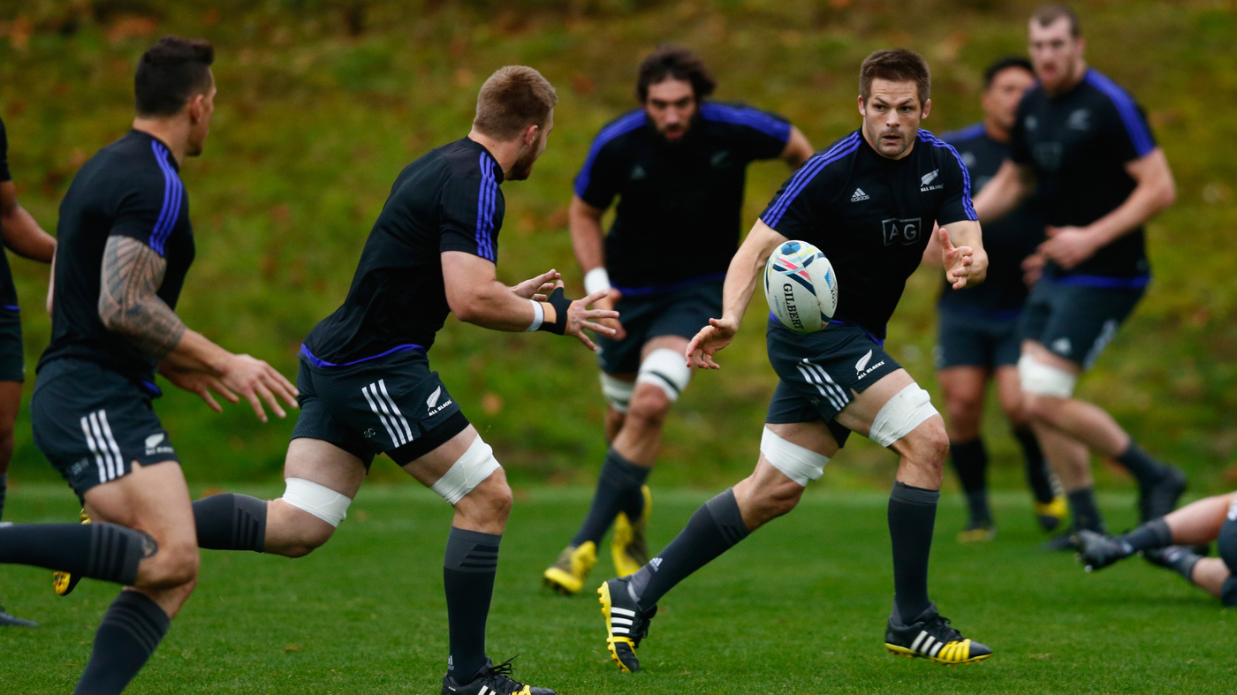
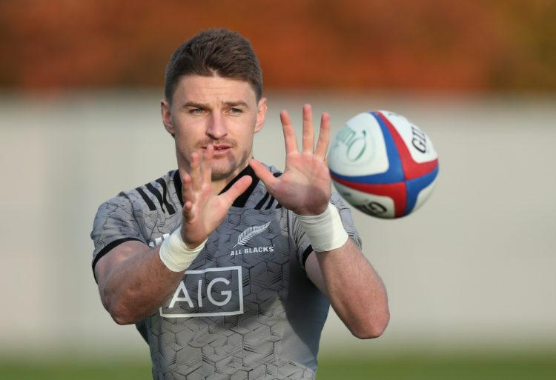
Subject Knowledge Organiser
Rugby
Subject Knowledge
Passing: The aim of passing is to keep possession of the ball within your team. We look to make passes over short distances to increase the chances of keeping possession of the ball.
Ball handling: Becoming familiar with the rugby ball is crucial in order to execute specific skills. You hold the rugby ball with two hands. You catch the ball by using the ‘W Grip’.
Key Terminology
Drop off
Contact zone
Running onto the ball
Reaction-time
Communication
Hand-eye co-ordination
Power
Tactics
Which type of pass should I select within a specific situation?
Which type of tackle should be executed?

Slide 5
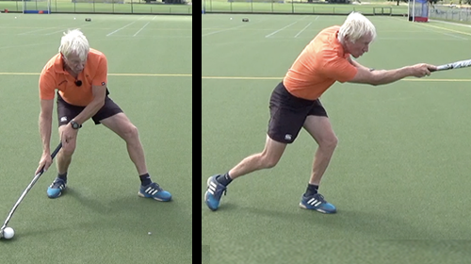
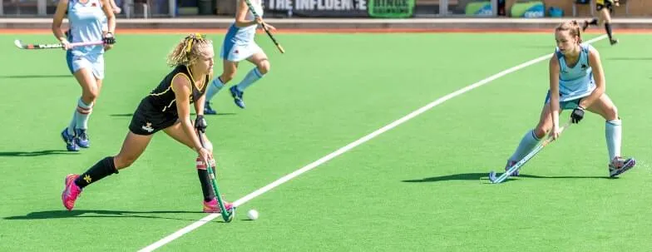
Subject Knowledge Organiser
Hockey
Subject Knowledge
Passing: The aim of passing is to keep possession of the ball within your team. We look to use the push pass over shorter distances and a drive over a longer distance by using the open stick.
Dribbling: Hockey players can dribble with the ball and look to use the head of the stick to keep close control of the ball. Always try to dribble in front of you when advancing down the pitch.
Key Terminology
Push pass
Drives
Co-ordination
Contact zone
Close control
Accuracy
Decision making
Tactics
Which type of pass should I select within a specific situation?
When should I dribble with the ball?

Slide 6
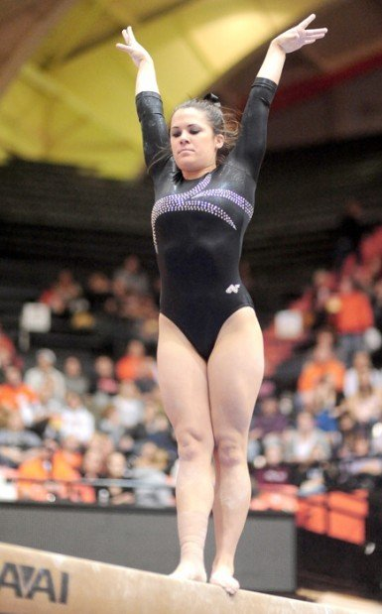
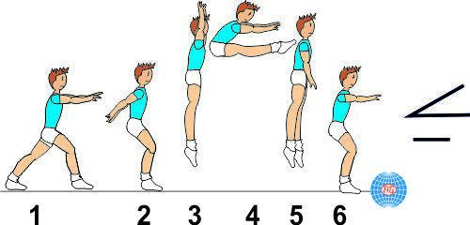
Subject Knowledge Organiser
Gymnastics
Subject Knowledge
Agilities: This is how you can adapt your routines to suit the needs of your partner. For example, forward rolls, pike jumps, backwards rolls.
Standards: You are expected to sit in the ready position. You put your hands flat on the floor, behind your back. Your sat with your legs out in front of you and your toes are pointing. You finish your routines with your hands in the air and on your tippy toes.
Key Terminology
Aesthetic Appreciation
Balance
Flexibility
Agility
Body tension
Core strength

Slide 7
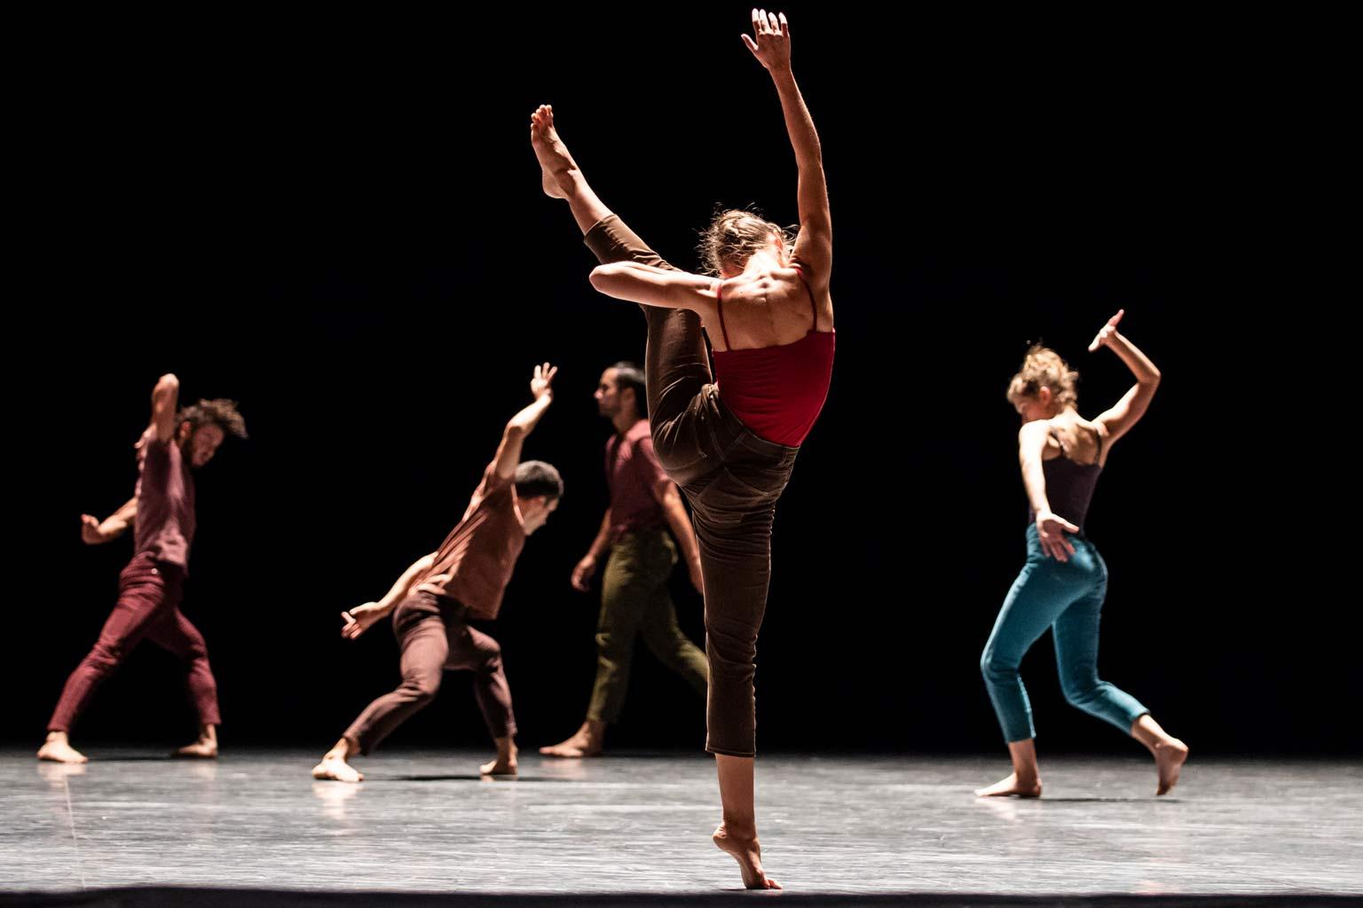
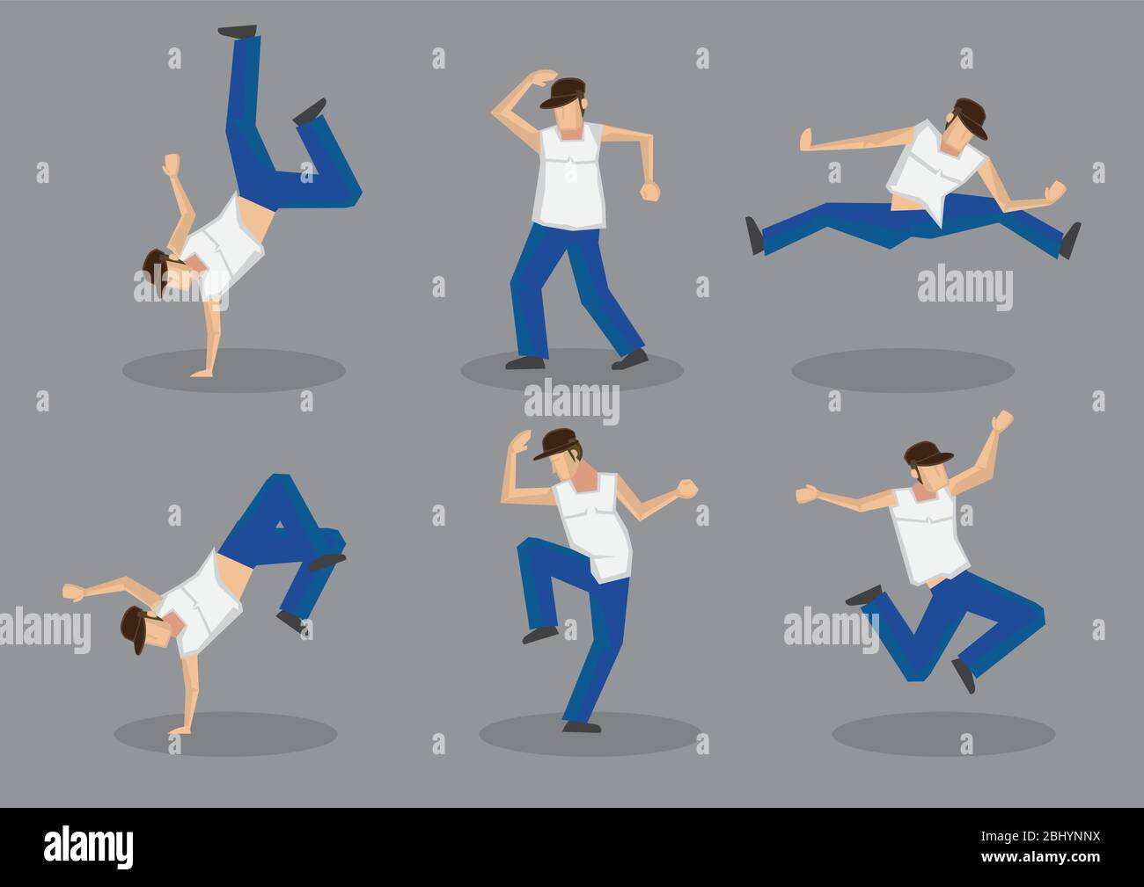
Subject Knowledge Organiser
Dance
Subject Knowledge
Motif: This is a dominant feature within the performance which is repeated throughout. This can be a single movement or a phrase of movement. This can be a theme within the performance.
Choreography: This is how you create the sequence of movements in line with a chosen piece of music. You can be creative with your movements and encapsulate the audience you are performing to.
Key Terminology
Motif
Fluency
Dynamic
Unison
Canon
Balance
Co-ordination

Slide 8
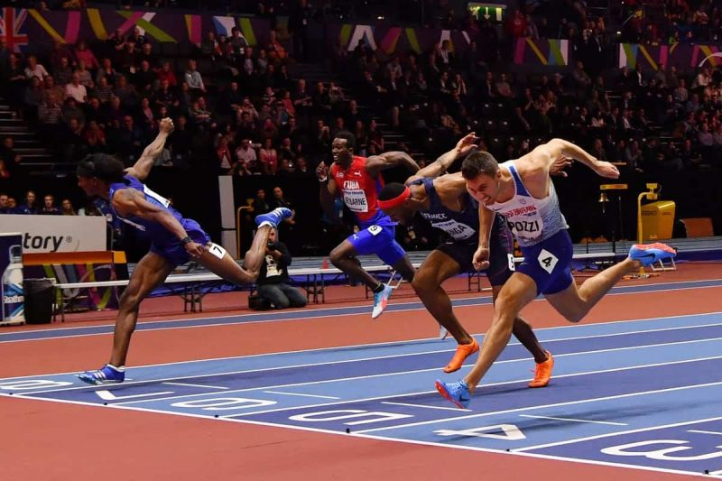
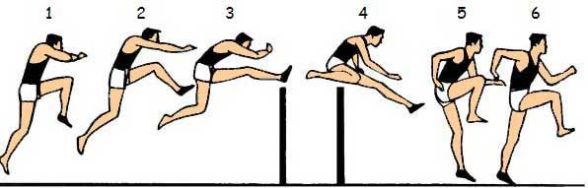
Subject Knowledge Organiser
Indoor Athletics
Subject Knowledge
Sprinting Technique: You drive forward through using the balls of your feet. Your knees drive upwards and forwards. Your arms are driving with fingers pointing forward. Head and your core a still throughout.
Hurdling Technique: Make sure that you know what leg to lead off from when gliding over the hurdle. Keep your head still and focused upon the finish line. Be aware that your trail leg has to go over the hurdle as well.
Key Terminology
Power
Speed
Agility
Reaction Time
Contact Point
Aerobic endurance
Co-ordination
Sprinting Technique
Pacing
Tactics
How can I order my team to win the relay event?
How can I pace myself when competing in middle distance events?

Slide 9

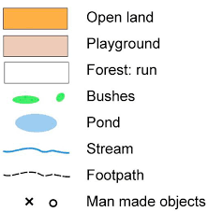
Subject Knowledge Organiser
OAA
Subject Knowledge
Symbols: Within orienteering there are key symbols that you may see on a map which you may need to identify. A triangle is used to indicate the start and a double circle indicates the finishing point.
Control Point: These are points within the map which you need to find. They may have directions of where to go next or you may need to write the control point down and decipher a code at the end of the route.
Key Terminology
Navigation
Teamwork
Communication
Leadership
Pacing
Cardinal Points
Resilience
Common goal
Tactics
How can we complete this task in the fastest time?
What do we need to think about when planning our route?

Slide 10
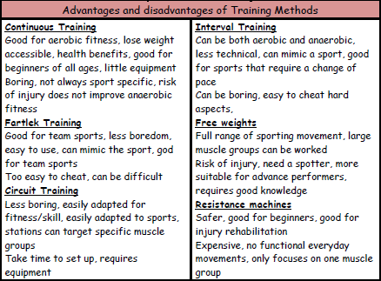
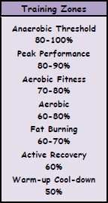
Subject Knowledge Organiser
Fitness
Training Methods
Training can be aerobic or anaerobic. In aerobic exercise, which is steady and not too fast, the heart is able to supply enough oxygen to the muscles. Aerobic training improves cardiovascular fitness. Anaerobic exercise is performed in short, fast bursts where the heart cannot supply enough oxygen to the muscles. Anaerobic training improves the ability of the muscles to work without enough oxygen when lactic acid is produced.
Specific training methods can be used to improve each fitness factor. Circuit training involves performing a series of exercises in a special order called a circuit. Each activity takes place at a 'station'. It can be designed to improve speed, agility, coordination, balance and muscular endurance. Continuous training involves working for a sustained period of time without rest. It improves cardio-vascular fitness. Cross training involves using another sport or activity to improve your fitness. It happens when an athlete trains in a different environment. For example a volleyball player uses the power training for that sport to help with fitness for long jump. Fartlek training or 'speed play' training involves varying your speed and the type of terrain over which you run, walk, cycle or ski. It improves aerobic and anaerobic fitness. Interval training involves alternating between periods of hard exercise and rest. It improves speed and muscular endurance. Weight training uses weights to provide resistance to the muscles. It improves muscular strength (high weight, low reps), muscular endurance (low weight, high reps, many sets) and power (medium weight and reps performed quickly).
Advantages and Disadvantages of Training Methods
Training Zones

Slide 11
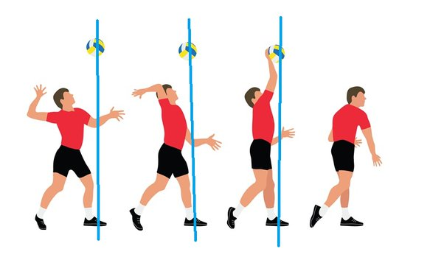
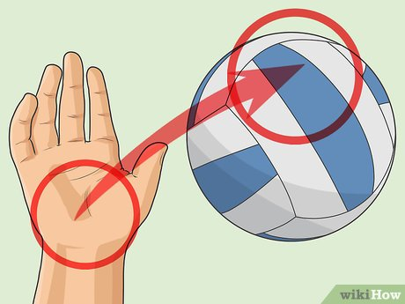
Subject Knowledge Organiser
Volleyball
Subject Knowledge
Overarm Serve: This is a serve in which the player tosses the ball with one hand and strikes it in the air above their head with the other hand. Make sure you contact the ball with an open palm.
Positioning: There are seven positions on a volleyball court: outside hitter, opposite setter, middle blocker, libero, defensive specialist, and serving specialist.
Key Terminology
Decision making
Strength
Speed
Agility
Co-ordination
Spatial awareness
Open palm
Bow and arrow
Tactics
What factors do we need to think when performing the overarm serve?
How can my team keep the ball after a serve?

Slide 12
Year 7 Half Term 2
Physical Education

Slide 13
Subject Knowledge Organiser
Football
Subject Knowledge
Passing: The aim of passing is to keep possession of the ball with your teammates. You can conduct this through executing a short pass, driven pass, and/or a lofted pass.
Turning Principles: Within a game scenario, there are opportunities to turn with the ball through executing the Cruyff Turn, drag back, inside toe-loop and/or outside toe-loop.
Key Terminology
Instep
Outside of the foot
Balance
Flexibility
Driven pass
Short pass
Lofted pass
Awareness
Tactics
How can I move the ball quickly within a game scenario?
Why would I turn with the football in a game scenario?.

Slide 14
Subject Knowledge Organiser
Netball
Subject Knowledge
Passing: The aim of passing is to keep possession of the ball with your teammates. You can conduct this through executing a bounce pass, chest pass, and/or a shoulder pass.
1st stage of defense: This defensive principle outlines the man to man marking which occurs within the game. This principle outlines how to mark a specific player on court.
Key Terminology
Awareness
Communication
Speed
Pace
Trajectory
Accuracy
Flexibility
Precision
Tactics
How can I move the ball quickly within a game scenario?
When would I use man to man marking in a game scenario?

Slide 15
Subject Knowledge Organiser
Hockey
Subject Knowledge
Passing: The aim of passing is to keep possession of the ball within your team. We look to use the push pass over shorter distances and a drive over a longer distance by using the open stick.
Dribbling: Hockey players can dribble with the ball and look to use the head of the stick to keep close control of the ball. Always try to dribble in front of you when advancing down the pitch.
Key Terminology
Push pass
Drives
Co-ordination
Contact zone
Close control
Accuracy
Decision making
Tactics
Which type of pass should I select within a specific situation?
When should I dribble with the ball?

Slide 16
Subject Knowledge Organiser
Gymnastics
Subject Knowledge
Agilities: This is how you can adapt your routines to suit the needs of your partner. For example, forward rolls, pike jumps, backwards rolls.
Standards: You are expected to sit in the ready position. You put your hands flat on the floor, behind your back. Your sat with your legs out in front of you and your toes are pointing. You finish your routines with your hands in the air and on your tippy toes.
Key Terminology
Aesthetic Appreciation
Balance
Flexibility
Agility
Body tension
Core strength

Slide 17
Year 7 Half Term 3
Physical Education

Slide 18
Subject Knowledge Organiser
Rugby
Subject Knowledge
Passing: The aim of passing is to keep possession of the ball within your team. We look to make passes over short distances to increase the chances of keeping possession of the ball.
Ball handling: Becoming familiar with the rugby ball is crucial in order to execute specific skills. You hold the rugby ball with two hands. You catch the ball by using the ‘W Grip’.
Key Terminology
Drop off
Contact zone
Running onto the ball
Reaction-time
Communication
Hand-eye co-ordination
Power
Tactics
Which type of pass should I select within a specific situation?
Which type of tackle should be executed?

Slide 19
Subject Knowledge Organiser
Gymnastics
Subject Knowledge
Agilities: This is how you can adapt your routines to suit the needs of your partner. For example, forward rolls, pike jumps, backwards rolls.
Standards: You are expected to sit in the ready position. You put your hands flat on the floor, behind your back. Your sat with your legs out in front of you and your toes are pointing. You finish your routines with your hands in the air and on your tippy toes.
Key Terminology
Aesthetic Appreciation
Balance
Flexibility
Agility
Body tension
Core strength

Slide 20
Subject Knowledge Organiser
Indoor Athletics
Subject Knowledge
Sprinting Technique: You drive forward through using the balls of your feet. Your knees drive upwards and forwards. Your arms are driving with fingers pointing forward. Head and your core a still throughout.
Hurdling Technique: Make sure that you know what leg to lead off from when gliding over the hurdle. Keep your head still and focused upon the finish line. Be aware that your trail leg has to go over the hurdle as well.
Key Terminology
Power
Speed
Agility
Reaction Time
Contact Point
Aerobic endurance
Co-ordination
Sprinting Technique
Pacing
Tactics
How can I order my team to win the relay event?
How can I pace myself when competing in middle distance events?

Slide 21
Subject Knowledge Organiser
OAA
Subject Knowledge
Symbols: Within orienteering there are key symbols that you may see on a map which you may need to identify. A triangle is used to indicate the start and a double circle indicates the finishing point.
Control Point: These are points within the map which you need to find. They may have directions of where to go next or you may need to write the control point down and decipher a code at the end of the route.
Key Terminology
Navigation
Teamwork
Communication
Leadership
Pacing
Cardinal Points
Resilience
Common goal
Tactics
How can we complete this task in the fastest time?
What do we need to think about when planning our route?

Slide 22
Subject Knowledge Organiser
Volleyball
Subject Knowledge
Overarm Serve: This is a serve in which the player tosses the ball with one hand and strikes it in the air above their head with the other hand. Make sure you contact the ball with an open palm.
Positioning: There are seven positions on a volleyball court: outside hitter, opposite setter, middle blocker, libero, defensive specialist, and serving specialist.
Key Terminology
Decision making
Strength
Speed
Agility
Co-ordination
Spatial awareness
Open palm
Bow and arrow
Tactics
What factors do we need to think when performing the overarm serve?
How can my team keep the ball after a serve?

Slide 23
Year 7 Half Term 4
Physical Education

Slide 24
Subject Knowledge Organiser
Rugby
Subject Knowledge
Passing: The aim of passing is to keep possession of the ball within your team. We look to make passes over short distances to increase the chances of keeping possession of the ball.
Ball handling: Becoming familiar with the rugby ball is crucial in order to execute specific skills. You hold the rugby ball with two hands. You catch the ball by using the ‘W Grip’.
Key Terminology
Drop off
Contact zone
Running onto the ball
Reaction-time
Communication
Hand-eye co-ordination
Power
Tactics
Which type of pass should I select within a specific situation?
Which type of tackle should be executed?

Slide 25
Subject Knowledge Organiser
OAA
Subject Knowledge
Symbols: Within orienteering there are key symbols that you may see on a map which you may need to identify. A triangle is used to indicate the start and a double circle indicates the finishing point.
Control Point: These are points within the map which you need to find. They may have directions of where to go next or you may need to write the control point down and decipher a code at the end of the route.
Key Terminology
Navigation
Teamwork
Communication
Leadership
Pacing
Cardinal Points
Resilience
Common goal
Tactics
How can we complete this task in the fastest time?
What do we need to think about when planning our route?

Slide 26
Subject Knowledge Organiser
Gymnastics
Subject Knowledge
Agilities: This is how you can adapt your routines to suit the needs of your partner. For example, forward rolls, pike jumps, backwards rolls.
Standards: You are expected to sit in the ready position. You put your hands flat on the floor, behind your back. Your sat with your legs out in front of you and your toes are pointing. You finish your routines with your hands in the air and on your tippy toes.
Key Terminology
Aesthetic Appreciation
Balance
Flexibility
Agility
Body tension
Core strength

Slide 27
Subject Knowledge Organiser
Hockey
Subject Knowledge
Passing: The aim of passing is to keep possession of the ball within your team. We look to use the push pass over shorter distances and a drive over a longer distance by using the open stick.
Dribbling: Hockey players can dribble with the ball and look to use the head of the stick to keep close control of the ball. Always try to dribble in front of you when advancing down the pitch.
Key Terminology
Push pass
Drives
Co-ordination
Contact zone
Close control
Accuracy
Decision making
Tactics
Which type of pass should I select within a specific situation?
When should I dribble with the ball?

Slide 28
Subject Knowledge Organiser
Volleyball
Subject Knowledge
Overarm Serve: This is a serve in which the player tosses the ball with one hand and strikes it in the air above their head with the other hand. Make sure you contact the ball with an open palm.
Positioning: There are seven positions on a volleyball court: outside hitter, opposite setter, middle blocker, libero, defensive specialist, and serving specialist.
Key Terminology
Decision making
Strength
Speed
Agility
Co-ordination
Spatial awareness
Open palm
Bow and arrow
Tactics
What factors do we need to think when performing the overarm serve?
How can my team keep the ball after a serve?

Slide 29
Year 7 Half Term 5
Physical Education

Slide 30
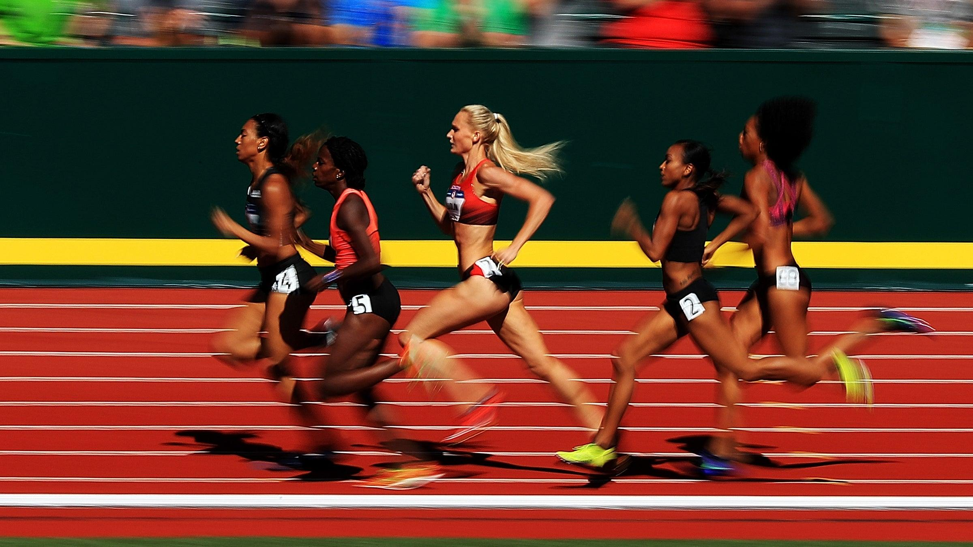
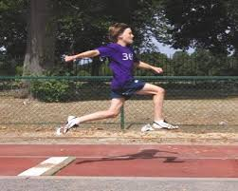
Subject Knowledge Organiser
Athletics
Subject Knowledge
Pacing: Within middle distance events, it is important to consider the speed in which you are running. You must pace yourself in order to finish the race and to leave something in the tank for the last 100m.
Health and Safety: It is important to follow the protocols for each event in order for you to be safe and your peers to be safe when partaking in the events.
Key Terminology
Pacing
Personal best
Optimum performance
Wide base of support
Recovery
Tactics
What aspect of the 100M should I be at my optimum speed?
What advantages could I use during the relay event?

Slide 31
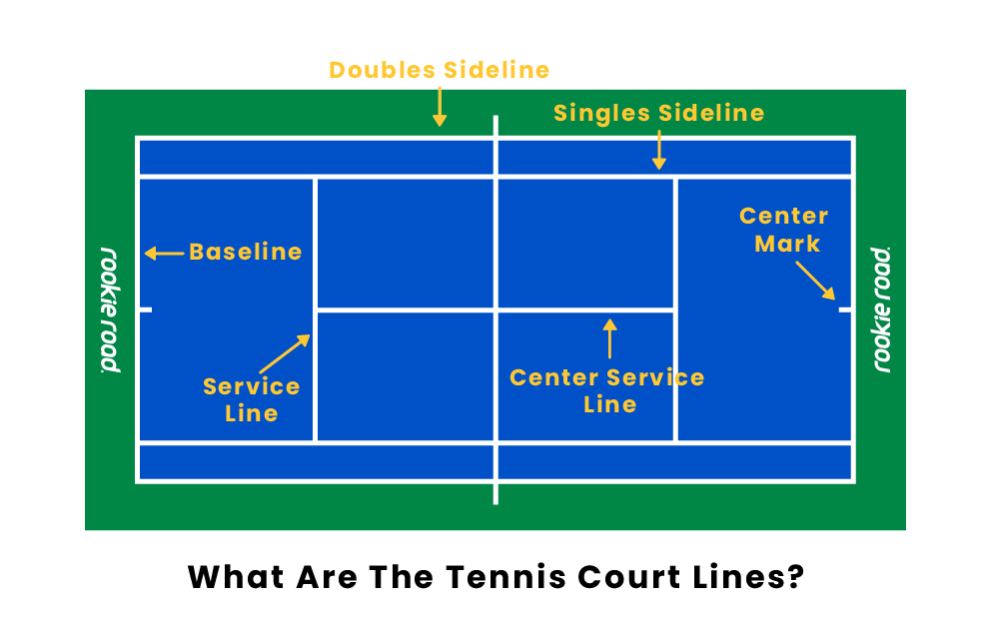
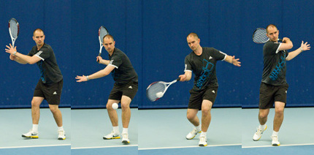
Subject Knowledge Organiser
Tennis
Subject Knowledge
Court Familiarization: You are gong to be able to identify lines on the court and the rules associated with this. Singles dimensions are narrow whereas doubles dimensions are wide.
Groundstrokes: In Tennis, there are two groundstrokes, forehand and backhand. Those are used to hit the ball over the net and land in the court dimensions.
Key Terminology
Forehand
Backhand
‘Knees to Trees’
Serve
Volley
Awareness
Shot selection
Tactics
How can I repeatedly hit the ball over the net?
How can I win a point against my opponent?

Slide 32
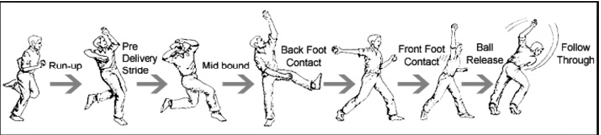
Subject Knowledge Organiser
Cricket
Subject Knowledge
Fielding Principles: In cricket, an important aspect of the game is fielding. This is either catching a ball, stopping a ball, throwing the ball back to the wicketkeeper.
Bowling Principles: Your aim is to hit the wickets at the batters end. You grip the ball with your fingers, conduct a steady run up, side on delivery action, with a high 12 o’clock release point.
Key Terminology
Underarm
Overarm
Retrieval
Sideways
Release point.
Co-ordination
Catching
Tactics
How can I get the ball to the wicketkeeper quicker?
How can I bowl a delivery which is going to cause them to be out?

Slide 33
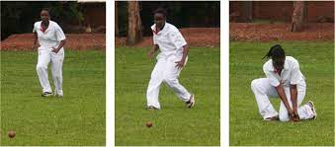
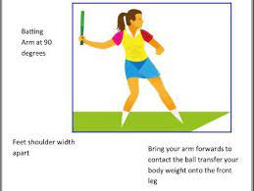
Subject Knowledge Organiser
Rounders/Softball
Subject Knowledge
Fielding Techniques: You will experience the rolling barrier which is used within shorter distances. You will also look at meeting the ball to perform a more efficient throw.
Batting Technique: Standing sideways on, using hand-eye co-ordination, hitting through the middle of the ball. Make sure that you stand within the designated square when you are batting!
Key Terminology
Long barrier
Rolling barrier
Backstop
Bowler
Batter
Tactics
What area of the pitch should I aim to hit the ball into?

Slide 34
Subject Knowledge Organiser
Fitness
Training Methods
Training can be aerobic or anaerobic. In aerobic exercise, which is steady and not too fast, the heart is able to supply enough oxygen to the muscles. Aerobic training improves cardiovascular fitness. Anaerobic exercise is performed in short, fast bursts where the heart cannot supply enough oxygen to the muscles. Anaerobic training improves the ability of the muscles to work without enough oxygen when lactic acid is produced.
Specific training methods can be used to improve each fitness factor. Circuit training involves performing a series of exercises in a special order called a circuit. Each activity takes place at a 'station'. It can be designed to improve speed, agility, coordination, balance and muscular endurance. Continuous training involves working for a sustained period of time without rest. It improves cardio-vascular fitness. Cross training involves using another sport or activity to improve your fitness. It happens when an athlete trains in a different environment. For example a volleyball player uses the power training for that sport to help with fitness for long jump. Fartlek training or 'speed play' training involves varying your speed and the type of terrain over which you run, walk, cycle or ski. It improves aerobic and anaerobic fitness. Interval training involves alternating between periods of hard exercise and rest. It improves speed and muscular endurance. Weight training uses weights to provide resistance to the muscles. It improves muscular strength (high weight, low reps), muscular endurance (low weight, high reps, many sets) and power (medium weight and reps performed quickly).
Advantages and Disadvantages of Training Methods
Training Zones

Slide 35
Year 7 Half Term 6
Physical Education

Slide 36
Subject Knowledge Organiser
Tennis
Subject Knowledge
Court Familiarization: You are gong to be able to identify lines on the court and the rules associated with this. Singles dimensions are narrow whereas doubles dimensions are wide.
Groundstrokes: In Tennis, there are two groundstrokes, forehand and backhand. Those are used to hit the ball over the net and land in the court dimensions.
Key Terminology
Forehand
Backhand
‘Knees to Trees’
Serve
Volley
Awareness
Shot selection
Tactics
How can I repeatedly hit the ball over the net?
How can I win a point against my opponent?

Slide 37
Subject Knowledge Organiser
Cricket
Subject Knowledge
Fielding Principles: In cricket, an important aspect of the game is fielding. This is either catching a ball, stopping a ball, throwing the ball back to the wicketkeeper.
Bowling Principles: Your aim is to hit the wickets at the batters end. You grip the ball with your fingers, conduct a steady run up, side on delivery action, with a high 12 o’clock release point.
Key Terminology
Underarm
Overarm
Retrieval
Sideways
Release point.
Co-ordination
Catching
Tactics
How can I get the ball to the wicketkeeper quicker?
How can I bowl a delivery which is going to cause them to be out?

Slide 38
Subject Knowledge Organiser
Rounders/Softball
Subject Knowledge
Fielding Techniques: You will experience the rolling barrier which is used within shorter distances. You will also look at meeting the ball to perform a more efficient throw.
Batting Technique: Standing sideways on, using hand-eye co-ordination, hitting through the middle of the ball. Make sure that you stand within the designated square when you are batting!
Key Terminology
Long barrier
Rolling barrier
Backstop
Bowler
Batter
Tactics
What area of the pitch should I aim to hit the ball into?

