Slide 1

Year 8 Half Term 1
Physical Education

Slide 2

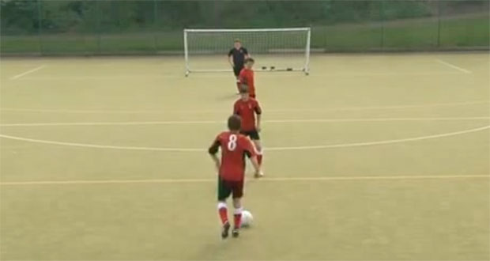
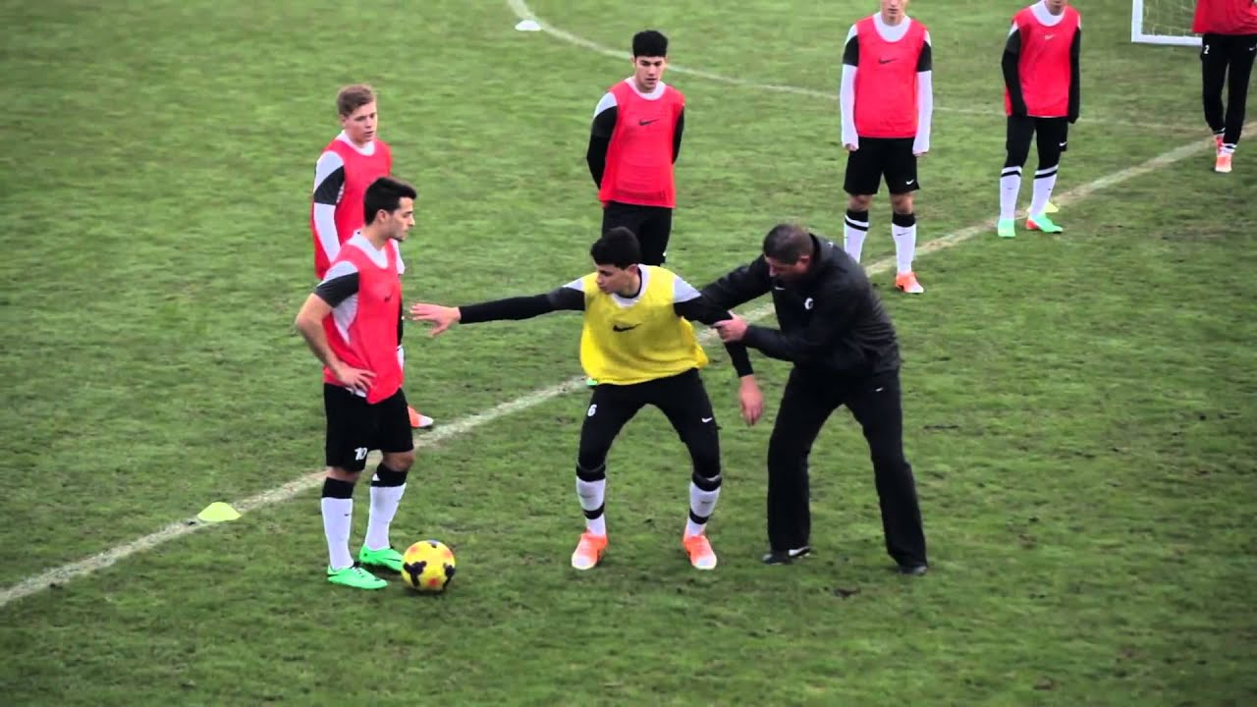
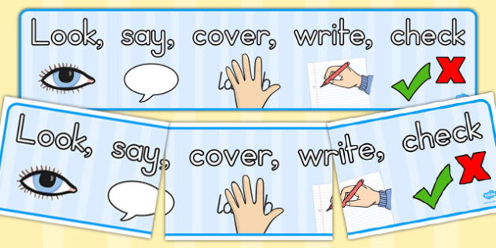
Subject Knowledge Organiser
Football
Subject Knowledge
Dribbling: The aim of dribbling is to outwit your opponent through moving the ball with both feet. You look to use the inside and outside of your foot to manipulate the ball pass your opponent.
Body shape: You look to use your body shape to enhance the trajectory and power of a defensive clearance. This can be conducted through either facing the ball or standing side on to the ball.
Key Terminology
Dribbling
Decision Making
Overloads
Creating Space
Body Shape
Inside Toe-Loop
Outside Toe-Loop
Balance
Defensive Header
Tactics
Outwitting your opponent in a 1v1 situation.
Creating overloads (2v1).
Selecting the correct pass at the right time.

Slide 3

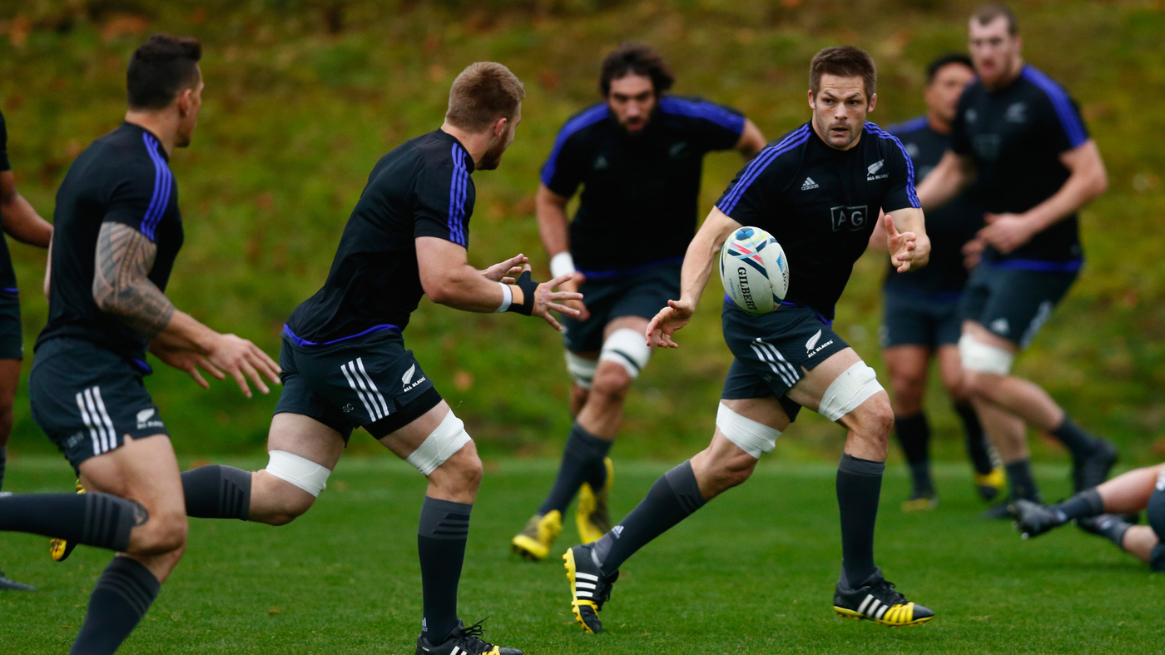
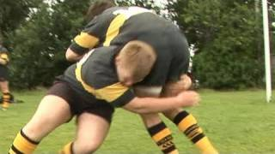
Subject Knowledge Organiser
Rugby
Subject Knowledge
Passing: The aim of passing is to keep possession of the ball within your team. We look to create depth when passing the ball so that your teammate can run onto the ball effectively.
Tackling: Your aim is to position yourself in the ‘cheek to cheek’ position to enable to bring down your opponent in a controlled and safe manner. Make sure you keep your head to the side of your opponent, so you don’t clash heads!
Key Terminology
Drop off
Contact zone
Running onto the ball
Reaction-time
Agility
Hand-eye co-ordination
Power
Tactics
Which type of pass should I select within a specific situation?
Which type of tackle should be executed?

Slide 4

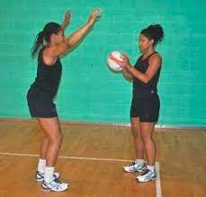
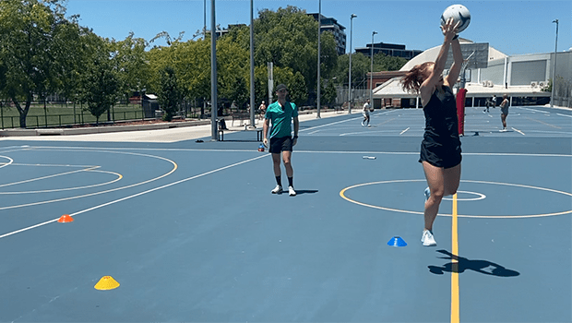
Subject Knowledge Organiser
Netball
Subject Knowledge
2nd stage of defense: This defensive principle outlines the 3ft marking of a player with the ball. You can only be 3ft away from the player that is in possession of the ball.
Single dodge: This is an attacking principle which is used to outwit your opponent. To incorporate this movement, you simply change direction from the balls of your feet.
Key Terminology
Offside
Change of direction
Chest pass
Shoulder pass
Bounce pass
2nd stage of defense
Applying pressure
Footwork
Decision making
Tactics
Selecting the correct pass to outwit your opponent.
Implementing the use of center and back line passes.

Slide 5

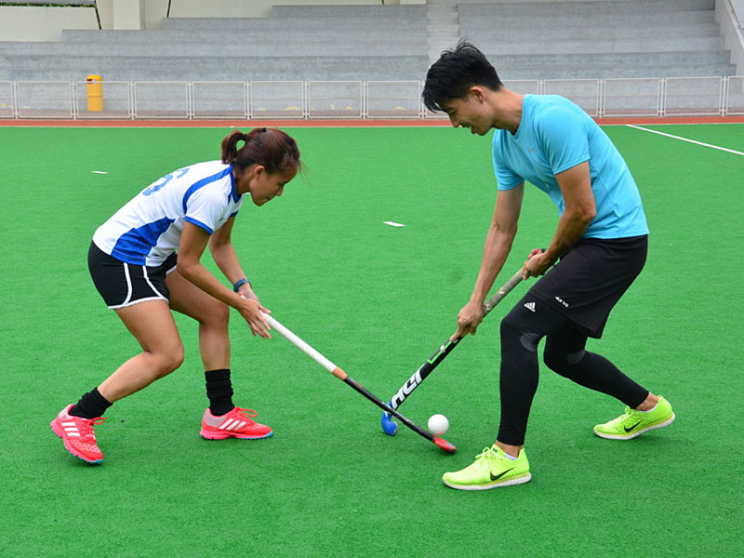
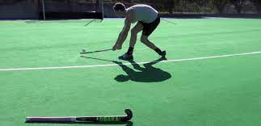
Subject Knowledge Organiser
Hockey
Subject Knowledge
The Reverse Hit: This shot is used to score goals. Make sure that your body is parallel to the target and the ball is off your right foot. The stick should stay in contact with the ground the entire time.
Jab Tackle: This defensive principle is used when the ball is unprotected. Players tend to lunge towards the ball with their left foot and take their right hand off the stick to increase their reach.
Key Terminology
Open stick
Reverse stick
Contact zone
Wide base
Agility
Balance
Co-ordination
Tactics
How can I create an overload for my team?
Why would I want to create an overload?
How can I outwit my opponent?

Slide 6
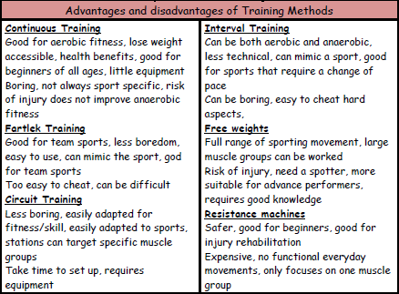
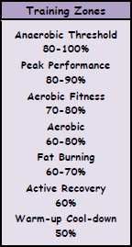
Subject Knowledge Organiser
Fitness
Training Methods
Training can be aerobic or anaerobic. In aerobic exercise, which is steady and not too fast, the heart is able to supply enough oxygen to the muscles. Aerobic training improves cardiovascular fitness. Anaerobic exercise is performed in short, fast bursts where the heart cannot supply enough oxygen to the muscles. Anaerobic training improves the ability of the muscles to work without enough oxygen when lactic acid is produced.
Specific training methods can be used to improve each fitness factor. Circuit training involves performing a series of exercises in a special order called a circuit. Each activity takes place at a 'station'. It can be designed to improve speed, agility, coordination, balance and muscular endurance. Continuous training involves working for a sustained period of time without rest. It improves cardio-vascular fitness. Cross training involves using another sport or activity to improve your fitness. It happens when an athlete trains in a different environment. For example a volleyball player uses the power training for that sport to help with fitness for long jump. Fartlek training or 'speed play' training involves varying your speed and the type of terrain over which you run, walk, cycle or ski. It improves aerobic and anaerobic fitness. Interval training involves alternating between periods of hard exercise and rest. It improves speed and muscular endurance. Weight training uses weights to provide resistance to the muscles. It improves muscular strength (high weight, low reps), muscular endurance (low weight, high reps, many sets) and power (medium weight and reps performed quickly).
Advantages and Disadvantages of Training Methods
Training Zones

Slide 7
Year 8 Half Term 2
Physical Education

Slide 8
Subject Knowledge Organiser
Football
Subject Knowledge
Dribbling: The aim of dribbling is to outwit your opponent through moving the ball with both feet. You look to use the inside and outside of your foot to manipulate the ball pass your opponent.
Body shape: You look to use your body shape to enhance the trajectory and power of a defensive clearance. This can be conducted through either facing the ball or standing side on to the ball.
Key Terminology
Dribbling
Decision Making
Overloads
Creating Space
Body Shape
Inside Toe-Loop
Outside Toe-Loop
Balance
Defensive Header
Tactics
Outwitting your opponent in a 1v1 situation.
Creating overloads (2v1).
Selecting the correct pass at the right time.

Slide 9
Subject Knowledge Organiser
Rugby
Subject Knowledge
Passing: The aim of passing is to keep possession of the ball within your team. We look to create depth when passing the ball so that your teammate can run onto the ball effectively.
Tackling: Your aim is to position yourself in the ‘cheek to cheek’ position to enable to bring down your opponent in a controlled and safe manner. Make sure you keep your head to the side of your opponent, so you don’t clash heads!
Key Terminology
Drop off
Contact zone
Running onto the ball
Reaction-time
Agility
Hand-eye co-ordination
Power
Tactics
Which type of pass should I select within a specific situation?
Which type of tackle should be executed?

Slide 10
Subject Knowledge Organiser
Hockey
Subject Knowledge
The Reverse Hit: This shot is used to score goals. Make sure that your body is parallel to the target and the ball is off your right foot. The stick should stay in contact with the ground the entire time.
Jab Tackle: This defensive principle is used when the ball is unprotected. Players tend to lunge towards the ball with their left foot and take their right hand off the stick to increase their reach.
Key Terminology
Open stick
Reverse stick
Contact zone
Wide base
Agility
Balance
Co-ordination
Tactics
How can I create an overload for my team?
Why would I want to create an overload?
How can I outwit my opponent?

Slide 11

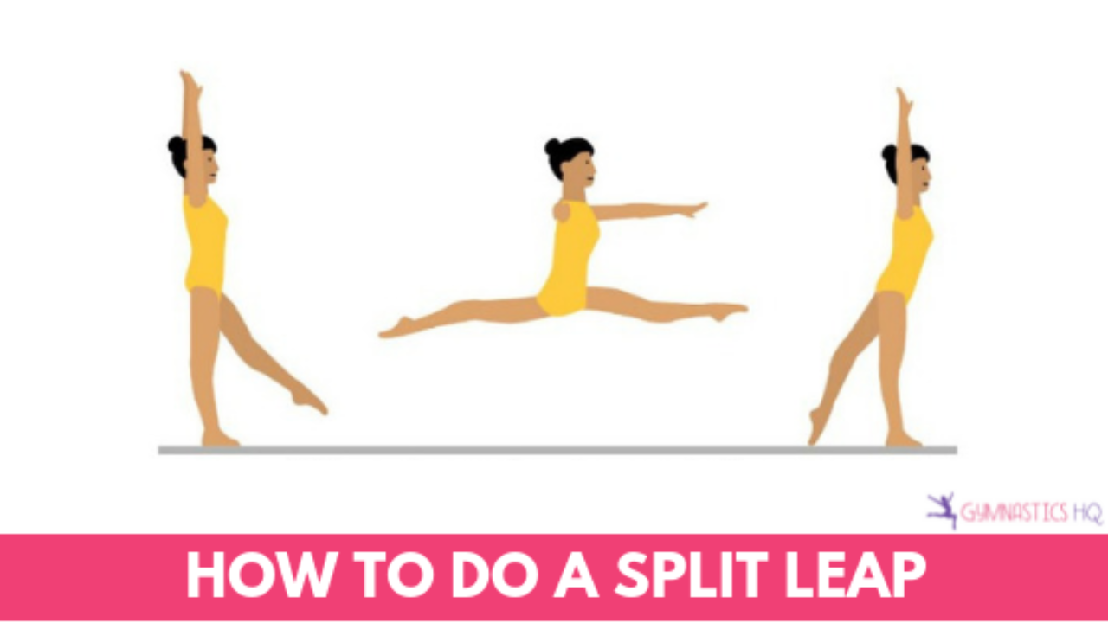
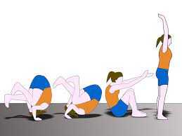
Subject Knowledge Organiser
Gymnastics
Subject Knowledge
Sequence: This is a set of movements which are combined through flight, travel, balance and/or rotations. A sequence of movement requires it to flow with the timings associated with your partner.
Skillful Agilities: You are expected to perform movements which incorporates strength, co-ordination, balance, and body tension. For example: a split jump, forward roll.
Key Terminology
Communication
Co-operation
Shape
Travel
Flight
Balance
Rotation
Counter-Balance
Aesthetics
Accurate Replication
Locomotion
Transference of weight
Body tension

Slide 12
Subject Knowledge Organiser
Fitness
Training Methods
Training can be aerobic or anaerobic. In aerobic exercise, which is steady and not too fast, the heart is able to supply enough oxygen to the muscles. Aerobic training improves cardiovascular fitness. Anaerobic exercise is performed in short, fast bursts where the heart cannot supply enough oxygen to the muscles. Anaerobic training improves the ability of the muscles to work without enough oxygen when lactic acid is produced.
Specific training methods can be used to improve each fitness factor. Circuit training involves performing a series of exercises in a special order called a circuit. Each activity takes place at a 'station'. It can be designed to improve speed, agility, coordination, balance and muscular endurance. Continuous training involves working for a sustained period of time without rest. It improves cardio-vascular fitness. Cross training involves using another sport or activity to improve your fitness. It happens when an athlete trains in a different environment. For example a volleyball player uses the power training for that sport to help with fitness for long jump. Fartlek training or 'speed play' training involves varying your speed and the type of terrain over which you run, walk, cycle or ski. It improves aerobic and anaerobic fitness. Interval training involves alternating between periods of hard exercise and rest. It improves speed and muscular endurance. Weight training uses weights to provide resistance to the muscles. It improves muscular strength (high weight, low reps), muscular endurance (low weight, high reps, many sets) and power (medium weight and reps performed quickly).
Advantages and Disadvantages of Training Methods
Training Zones

Slide 13

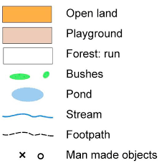
Subject Knowledge Organiser
OAA
Subject Knowledge
Symbols: Within orienteering there are key symbols that you may see on a map which you may need to identify. A triangle is used to indicate the start and a double circle indicates the finishing point.
Control Point: These are points within the map which you need to find. They may have directions of where to go next or you may need to write the control point down and decipher a code at the end of the route.
Key Terminology
Navigation
Teamwork
Communication
Leadership
Pacing
Cardinal Points
Resilience
Common goal
Tactics
How can we complete this task in the fastest time?
What do we need to think about when planning our route?

Slide 14
Year 8 Half Term 3
Physical Education

Slide 15
Subject Knowledge Organiser
Football
Subject Knowledge
Dribbling: The aim of dribbling is to outwit your opponent through moving the ball with both feet. You look to use the inside and outside of your foot to manipulate the ball pass your opponent.
Body shape: You look to use your body shape to enhance the trajectory and power of a defensive clearance. This can be conducted through either facing the ball or standing side on to the ball.
Key Terminology
Dribbling
Decision Making
Overloads
Creating Space
Body Shape
Inside Toe-Loop
Outside Toe-Loop
Balance
Defensive Header
Tactics
Outwitting your opponent in a 1v1 situation.
Creating overloads (2v1).
Selecting the correct pass at the right time.

Slide 16
Subject Knowledge Organiser
Hockey
Subject Knowledge
The Reverse Hit: This shot is used to score goals. Make sure that your body is parallel to the target and the ball is off your right foot. The stick should stay in contact with the ground the entire time.
Jab Tackle: This defensive principle is used when the ball is unprotected. Players tend to lunge towards the ball with their left foot and take their right hand off the stick to increase their reach.
Key Terminology
Open stick
Reverse stick
Contact zone
Wide base
Agility
Balance
Co-ordination
Tactics
How can I create an overload for my team?
Why would I want to create an overload?
How can I outwit my opponent?

Slide 17
Subject Knowledge Organiser
Gymnastics
Subject Knowledge
Sequence: This is a set of movements which are combined through flight, travel, balance and/or rotations. A sequence of movement requires it to flow with the timings associated with your partner.
Skillful Agilities: You are expected to perform movements which incorporates strength, co-ordination, balance, and body tension. For example: a split jump, forward roll.
Key Terminology
Communication
Co-operation
Shape
Travel
Flight
Balance
Rotation
Counter-Balance
Aesthetics
Accurate Replication
Locomotion
Transference of weight
Body tension

Slide 18
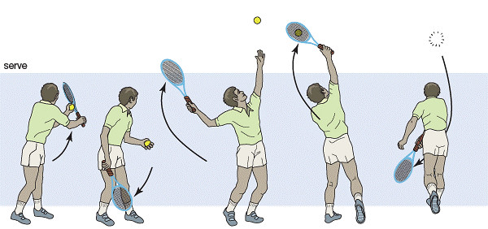
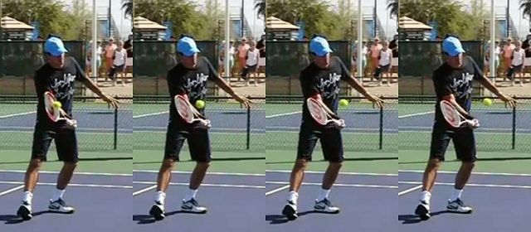
Subject Knowledge Organiser
Tennis
Subject Knowledge
Serving: Start with the racket and the ball together. Racket moves down and back with the ball moving forward. Arms are wide apart when the ball is tossed up. Contact point is high and in front of your body.
Volleying: Solid base with your feet shoulder width apart. Turn the upper body when executing the shot. You use a punch action and not a swinging action to execute this shot correctly.
Key Terminology
Low to High
Contact Point
Preparatory phase
Execution Phase
Follow through Phase
Ball toss
Co-ordination
Tactics
How can I achieve an ace?
When would I use a volley to win a point?
What shot should I select within a game?

Slide 19
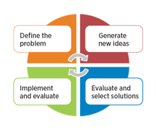
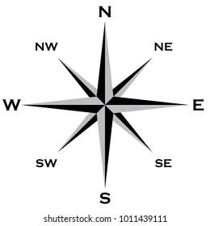
Subject Knowledge Organiser
OAA
Subject Knowledge
Problem Solving: This is a transferable skill that uses deeper thinking strategies to solve problems.
Leadership: Promotes individuals that are steering their team towards a common goal. This is achieved through communication, teamwork and resilience.
Cardinal Points: Those points are situated in the direction of travel. For example: North, East, South, West,
Key Terminology
Navigation
Teamwork
Communication
Resilience
Leadership
Co-ordination
Pacing
Cardinal Points
Tactics
How can we work as a team to achieve a common goal?
What factors affect team morale?

Slide 20
Year 8 Half Term 4
Physical Education

Slide 21
Subject Knowledge Organiser
Gymnastics
Subject Knowledge
Sequence: This is a set of movements which are combined through flight, travel, balance and/or rotations. A sequence of movement requires it to flow with the timings associated with your partner.
Skillful Agilities: You are expected to perform movements which incorporates strength, co-ordination, balance, and body tension. For example: a split jump, forward roll.
Key Terminology
Communication
Co-operation
Shape
Travel
Flight
Balance
Rotation
Counter-Balance
Aesthetics
Accurate Replication
Locomotion
Transference of weight
Body tension

Slide 22
Subject Knowledge Organiser
OAA
Subject Knowledge
Symbols: Within orienteering there are key symbols that you may see on a map which you may need to identify. A triangle is used to indicate the start and a double circle indicates the finishing point.
Control Point: These are points within the map which you need to find. They may have directions of where to go next or you may need to write the control point down and decipher a code at the end of the route.
Key Terminology
Navigation
Teamwork
Communication
Leadership
Pacing
Cardinal Points
Resilience
Common goal
Tactics
How can we complete this task in the fastest time?
What do we need to think about when planning our route?

Slide 23
Subject Knowledge Organiser
Hockey
Subject Knowledge
The Reverse Hit: This shot is used to score goals. Make sure that your body is parallel to the target and the ball is off your right foot. The stick should stay in contact with the ground the entire time.
Jab Tackle: This defensive principle is used when the ball is unprotected. Players tend to lunge towards the ball with their left foot and take their right hand off the stick to increase their reach.
Key Terminology
Open stick
Reverse stick
Contact zone
Wide base
Agility
Balance
Co-ordination
Tactics
How can I create an overload for my team?
Why would I want to create an overload?
How can I outwit my opponent?

Slide 24
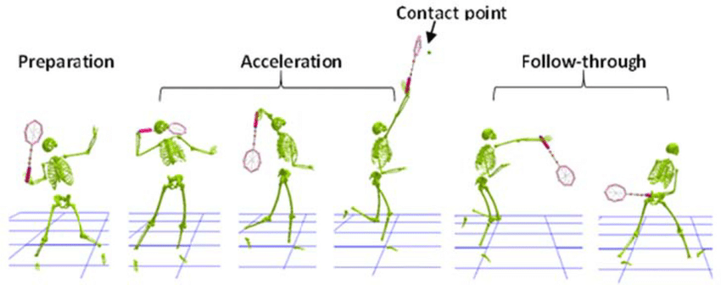
Subject Knowledge Organiser
Badminton
Subject Knowledge
Overhead Smash: This is an offensive shot that is intended to end the point on that shot. This shot has the same principles of an overhead clear but your wrist produces a snapping motion towards the net.
Forehand Drop Shot: This shot is used to draw your opponent to the front of the court. Your racket head needs to be slightly open before contact. You are slicing across the shuttlecock.
Key Terminology
Ready position
High contact point
Follow through
Decision making
Co-ordination
Spatial awareness
Awareness
Tactics
When would I use both of those shots?
What are the benefits of playing those shots?

Slide 25
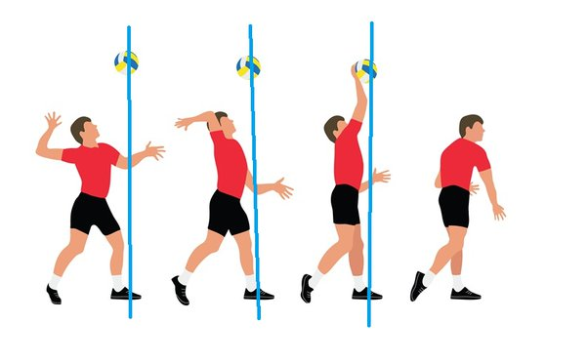
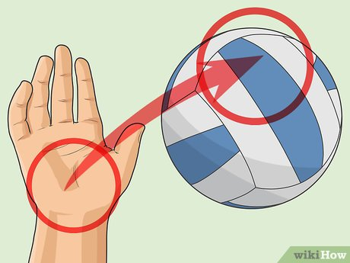
Subject Knowledge Organiser
Volleyball
Subject Knowledge
Overarm Serve: This is a serve in which the player tosses the ball with one hand and strikes it in the air above their head with the other hand. Make sure you contact the ball with an open palm.
Positioning: There are seven positions on a volleyball court: outside hitter, opposite setter, middle blocker, libero, defensive specialist, and serving specialist.
Key Terminology
Decision making
Strength
Speed
Agility
Co-ordination
Spatial awareness
Open palm
Bow and arrow
Tactics
What factors do we need to think when performing the overarm serve?
How can my team keep the ball after a serve?

Slide 26
Year 8 Half Term 5
Physical Education

Slide 27
Subject Knowledge Organiser
Fitness
Training Methods
Training can be aerobic or anaerobic. In aerobic exercise, which is steady and not too fast, the heart is able to supply enough oxygen to the muscles. Aerobic training improves cardiovascular fitness. Anaerobic exercise is performed in short, fast bursts where the heart cannot supply enough oxygen to the muscles. Anaerobic training improves the ability of the muscles to work without enough oxygen when lactic acid is produced.
Specific training methods can be used to improve each fitness factor. Circuit training involves performing a series of exercises in a special order called a circuit. Each activity takes place at a 'station'. It can be designed to improve speed, agility, coordination, balance and muscular endurance. Continuous training involves working for a sustained period of time without rest. It improves cardio-vascular fitness. Cross training involves using another sport or activity to improve your fitness. It happens when an athlete trains in a different environment. For example a volleyball player uses the power training for that sport to help with fitness for long jump. Fartlek training or 'speed play' training involves varying your speed and the type of terrain over which you run, walk, cycle or ski. It improves aerobic and anaerobic fitness. Interval training involves alternating between periods of hard exercise and rest. It improves speed and muscular endurance. Weight training uses weights to provide resistance to the muscles. It improves muscular strength (high weight, low reps), muscular endurance (low weight, high reps, many sets) and power (medium weight and reps performed quickly).
Advantages and Disadvantages of Training Methods
Training Zones

Slide 28
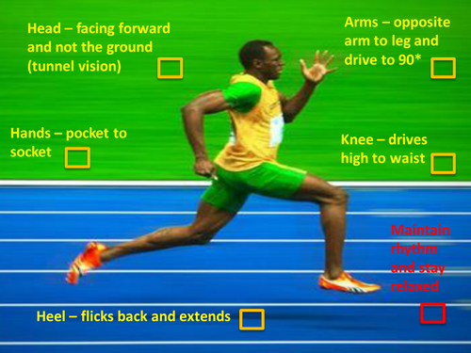
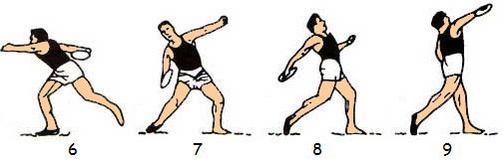
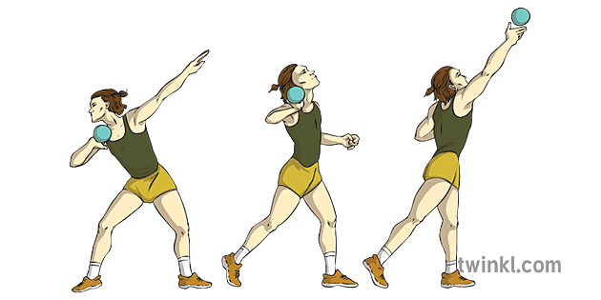
Subject Knowledge Organiser
Athletics
Subject Knowledge
Sprinting Technique: You drive forward through using the balls of your feet. Your knees drive upwards and forwards. Your arms are driving with fingers pointing forward. Head and your core a still throughout.
Throwing events: Focus upon being sideways on with your chin, knee and toe being together on a vertical line. Bend down low with your body weight towards your back foot. Watch the equipment go at the end of the sequence.
Key Terminology
Sprint
Drive Phase
Pacing
Take Off
Flight
Landing
Recovery
Aerobic endurance
Tactics
In middle distance races, how am I going to pace myself?
In track events, how can I use my attempts effectively?

Slide 29
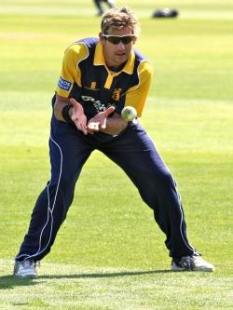
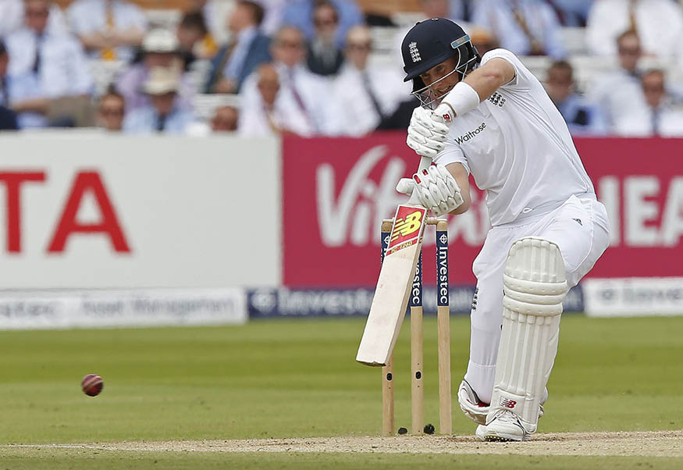
Subject Knowledge Organiser
Cricket
Subject Knowledge
Striking the ball: Your more effective using a straight bat when making contact with the ball, using your hands to drive the bat down. This will enable the face of the bat to be open for a full contact.
Catching technique: Make sure that your two little fingers are next to each other to create a larger surface area for the ball to go into. Cushion the impact of the ball by bringing your hands closer to you body.
Key Terminology
Long Barrier
Pick Up
High Release
Stance
Grip
Balance
Weight Transfer
Tactics
What ways can I get my opponent out?
How can I create pressure onto the batter?

Slide 30
Subject Knowledge Organiser
Tennis
Subject Knowledge
Serving: Start with the racket and the ball together. Racket moves down and back with the ball moving forward. Arms are wide apart when the ball is tossed up. Contact point is high and in front of your body.
Volleying: Solid base with your feet shoulder width apart. Turn the upper body when executing the shot. You use a punch action and not a swinging action to execute this shot correctly.
Key Terminology
Low to High
Contact Point
Preparatory phase
Execution Phase
Follow through Phase
Ball toss
Co-ordination
Tactics
How can I achieve an ace?
When would I use a volley to win a point?
What shot should I select within a game?

Slide 31
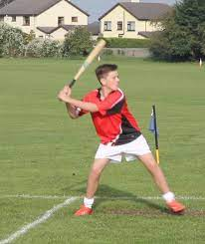
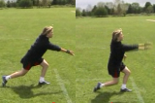
Subject Knowledge Organiser
Rounders
Subject Knowledge
Batting: When your batting, make sure that you use all of the area available to you. Aim to hit the middle of the ball.
Bowling: Make sure that you bowl underarm. You can add pace to your throw, the ball can be looped or spin can be added. Aim below the shoulder and above the knee of the batter.
Key Terminology
Under arm Throw
Overarm Throw
Long Barrier
Hand-eye Co-ordination
Bowler
Backstop
Tactics
Can your team field effectively from all areas of the pitch?
Where can you hit the ball to score a full rounder?

Slide 32
Year 8 Half Term 6
Physical Education

Slide 33
Subject Knowledge Organiser
Cricket
Subject Knowledge
Striking the ball: Your more effective using a straight bat when making contact with the ball, using your hands to drive the bat down. This will enable the face of the bat to be open for a full contact.
Catching technique: Make sure that your two little fingers are next to each other to create a larger surface area for the ball to go into. Cushion the impact of the ball by bringing your hands closer to you body.
Key Terminology
Long Barrier
Pick Up
High Release
Stance
Grip
Balance
Weight Transfer
Tactics
What ways can I get my opponent out?
How can I create pressure onto the batter?

Slide 34
Subject Knowledge Organiser
Tennis
Subject Knowledge
Serving: Start with the racket and the ball together. Racket moves down and back with the ball moving forward. Arms are wide apart when the ball is tossed up. Contact point is high and in front of your body.
Volleying: Solid base with your feet shoulder width apart. Turn the upper body when executing the shot. You use a punch action and not a swinging action to execute this shot correctly.
Key Terminology
Low to High
Contact Point
Preparatory phase
Execution Phase
Follow through Phase
Ball toss
Co-ordination
Tactics
How can I achieve an ace?
When would I use a volley to win a point?
What shot should I select within a game?

Slide 35
Subject Knowledge Organiser
Rounders/ Softball
Subject Knowledge
Batting: When your batting, make sure that you use all of the area available to you. Aim to hit the middle of the ball.
Bowling: Make sure that you bowl underarm. You can add pace to your throw, the ball can be looped or spin can be added. Aim below the shoulder and above the knee of the batter.
Key Terminology
Under arm Throw
Overarm Throw
Long Barrier
Hand-eye Co-ordination
Bowler
Backstop
Tactics
Can your team field effectively from all areas of the pitch?
Where can you hit the ball to score a full rounder?

