Slide 1

Year 9 Half Term 1
Physical Education

Slide 2
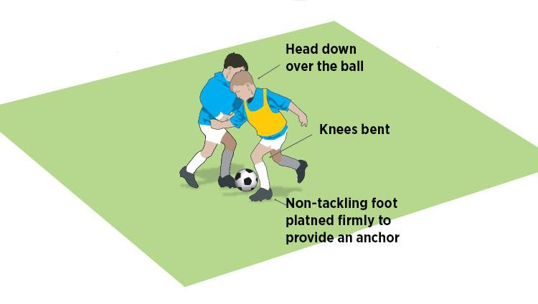
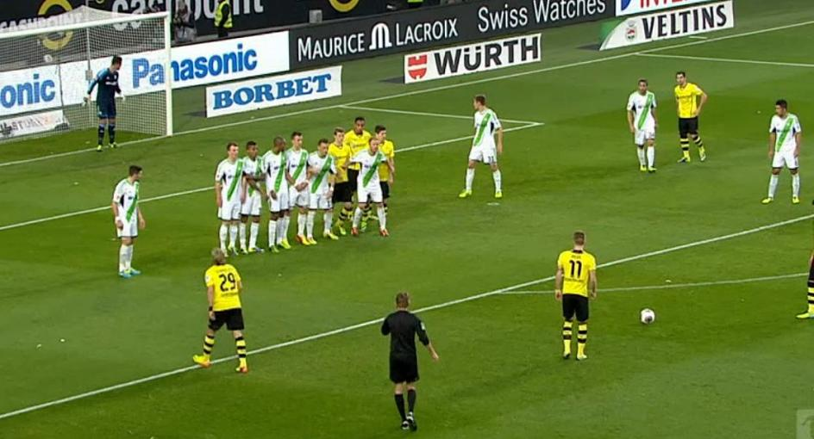
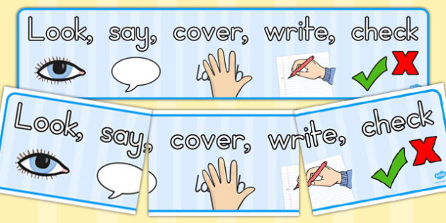
Subject Knowledge Organiser
Football
Subject Knowledge
Set Pieces: Within the game, there are a few set pieces that are taken. They are: corners, direct and indirect free kicks, throw ins.
Block Tackle: This technique is the most commonly used in football. You watch the ball and wait for your opportunity to block the ball with the inside of your foot.
Key Terminology
Decision Making
Overloads
Creating Space
Body Shape
Balance
Spatial awareness
Co-ordination
Communication
Tactics
How can we score a goal from a set play?
How can I stop the shot in a conditioned game?

Slide 3
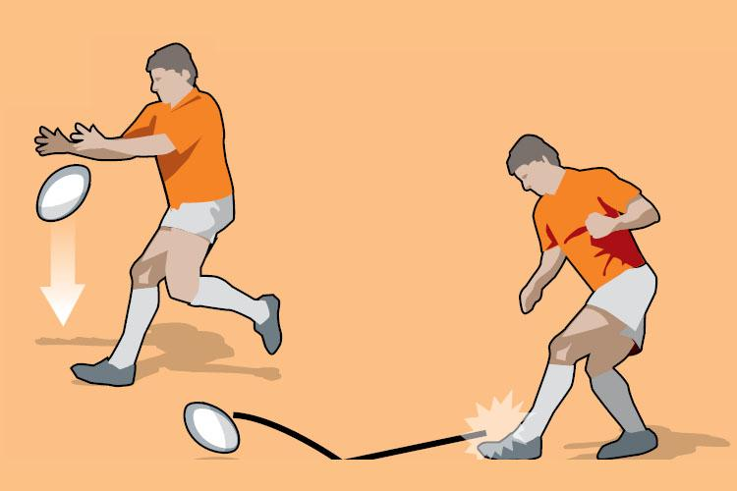
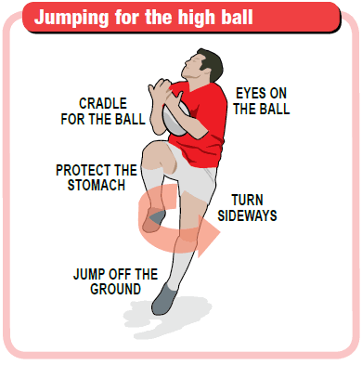
Subject Knowledge Organiser
Rugby
Subject Knowledge
High Ball Catch: This technique is used when the opposition put a high kick into the air. Make sure that you have a solid base and both your arms are pointing in the air. This creates the basket for the ball to land into.
Grubber Kick: This is an attacking kick used to either score a try or break the defensive line. Point the rugby ball towards the ground and use your laces to strike the ball.
Key Terminology
Accuracy
Reaction-time
Agility
Hand-eye co-ordination
Power
Finesse
Decision making
Tactics
Which type of kick should I use on the last tackle?
What can I do to make sure that I have a high completion rate of passes?

Slide 4
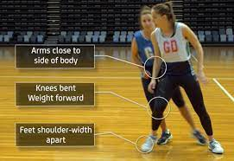
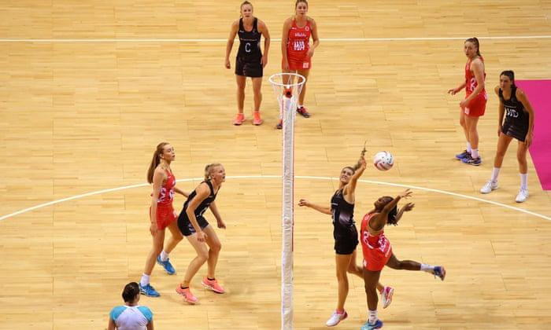
Subject Knowledge Organiser
Netball
Subject Knowledge
3rd stage of defense: This defensive principle outlines slowing the player down once they have released the ball and prevents the space for them to move into.
Creating Space: This attacking principle looks at how we can time movements on court in relation to the opposition. This will generate a quick transition from defense to attack.
Key Terminology
3rd stage of defense
Applying pressure
Footwork
Decision making
Strength
Speed
Agility
Tactics
How do we as a team create space effectively?
How can we transition quickly from defense to attack?

Slide 5
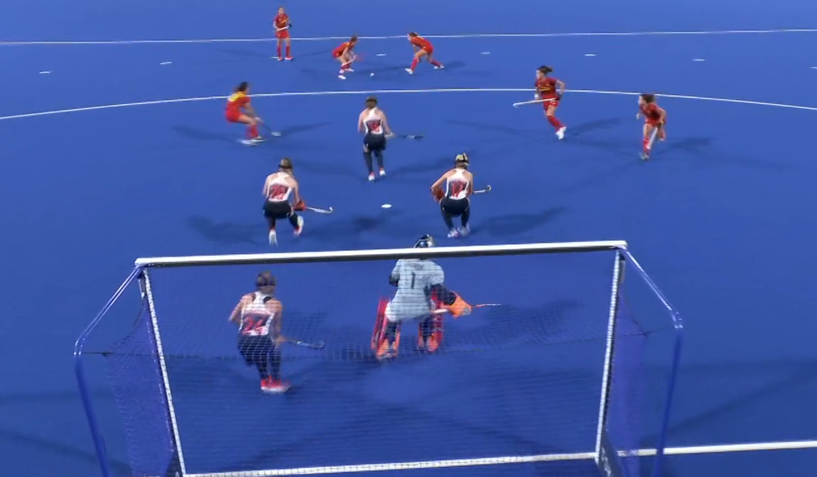
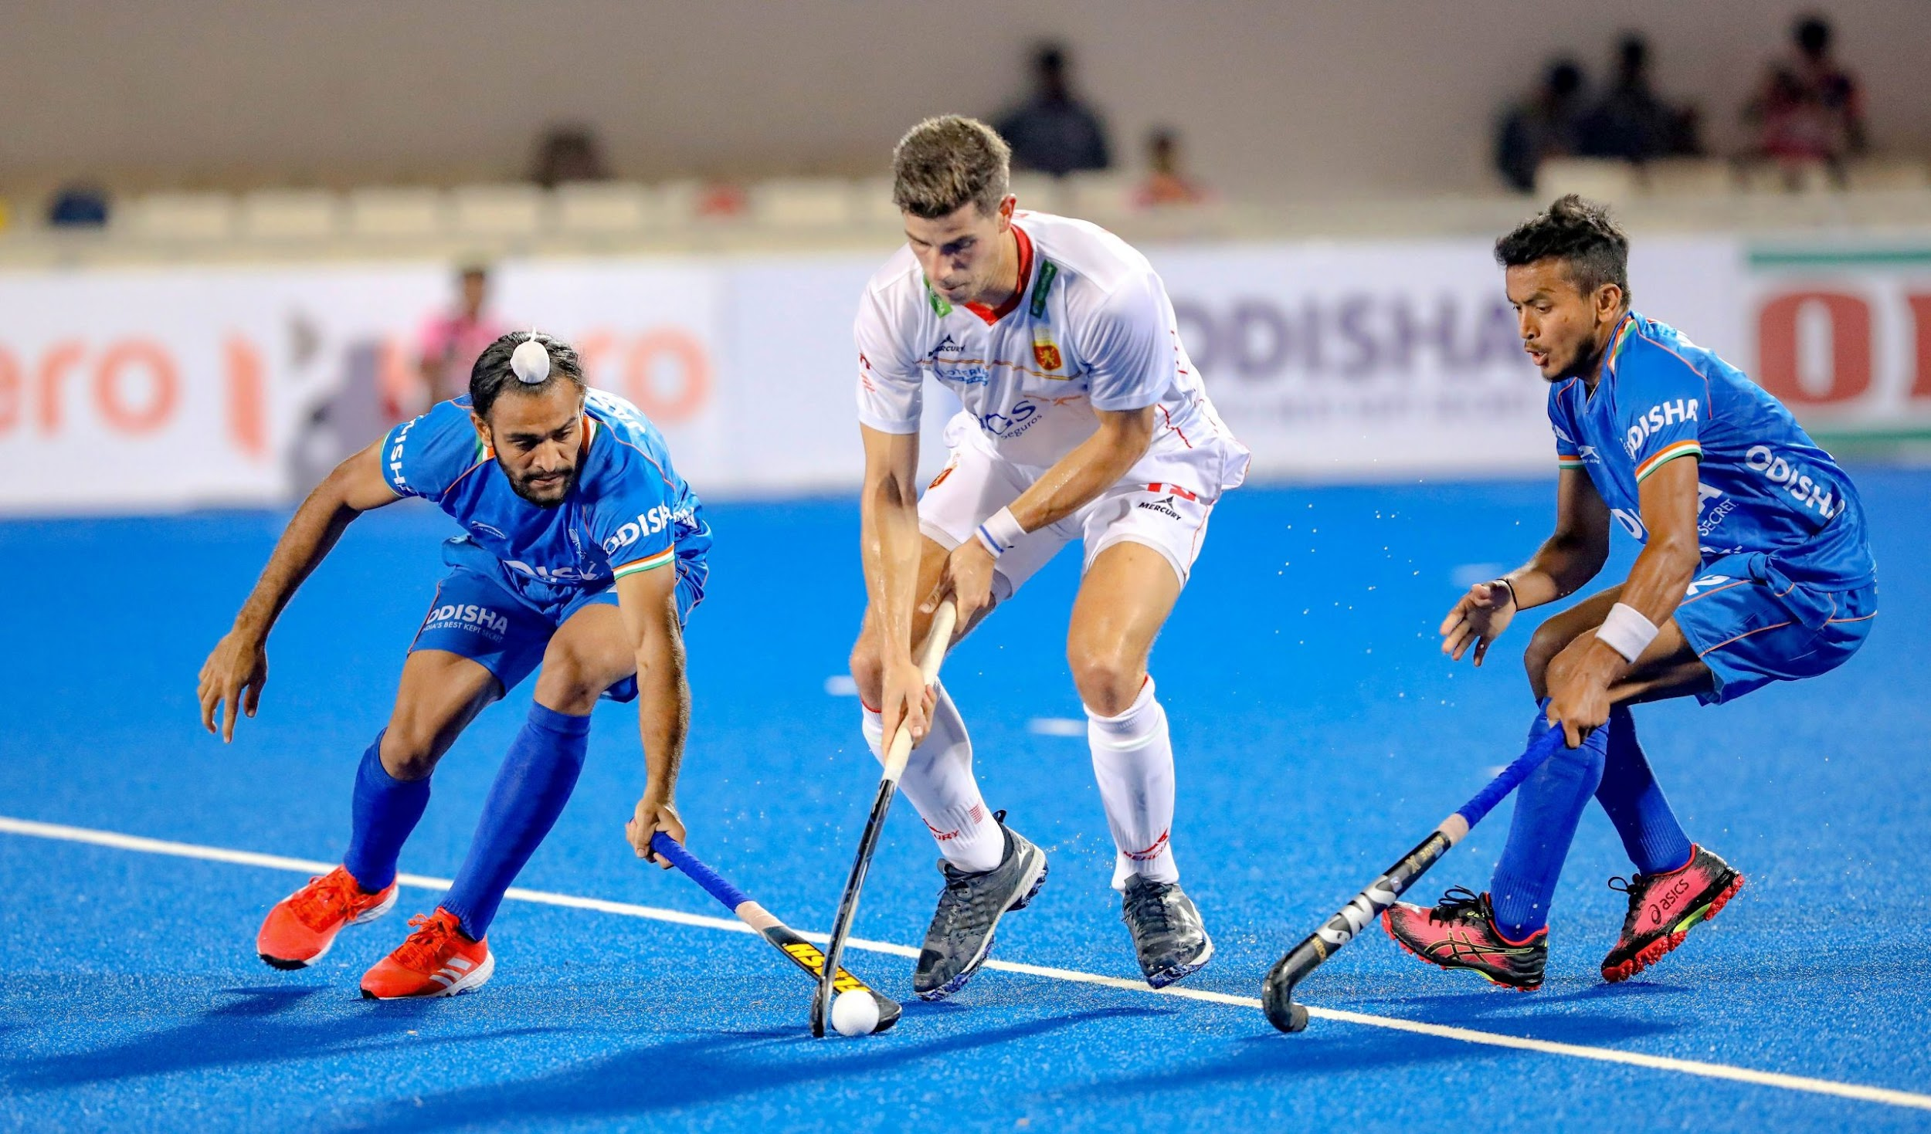
Subject Knowledge Organiser
Hockey
Subject Knowledge
Set Pieces: Within the game, there are a few set pieces that are taken. They are: short corners, penalty corners, hit in and restarts from a foul.
Outwitting the Opponent: Within any invasion game, you are always looking at creating opportunities to score a goal or create an overload in the attacking third.
Key Terminology
Applying pressure
Footwork
Decision making
Strength
Speed
Agility
Co-ordination
Spatial awareness
Tactics
What factors do we need to think about from a short corner?
How can we outwit the opponent on set plays?

Slide 6
Year 9 Half Term 2
Physical Education

Slide 7
Subject Knowledge Organiser
Football
Subject Knowledge
Set Pieces: Within the game, there are a few set pieces that are taken. They are: corners, direct and indirect free kicks, throw ins.
Block Tackle: This technique is the most commonly used in football. You watch the ball and wait for your opportunity to block the ball with the inside of your foot.
Key Terminology
Decision Making
Overloads
Creating Space
Body Shape
Balance
Spatial awareness
Co-ordination
Communication
Tactics
How can we score a goal from a set play?
How can I stop the shot in a conditioned game?

Slide 8

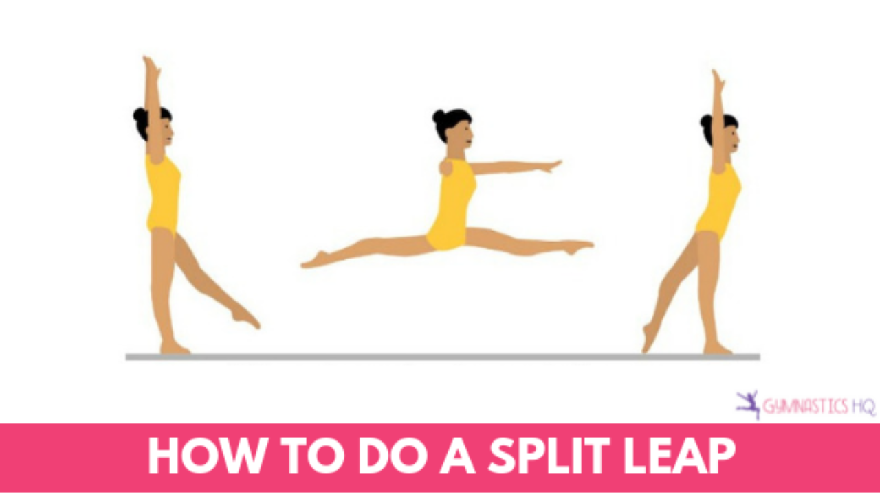
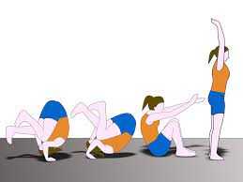
Subject Knowledge Organiser
Gymnastics
Subject Knowledge
Sequence: This is a set of movements which are combined through flight, travel, balance and/or rotations. A sequence of movement requires it to flow with the timings associated with your partner.
Skillful Agilities: You are expected to perform movements which incorporates strength, co-ordination, balance, and body tension. For example: a split jump, forward roll.
Key Terminology
Communication
Co-operation
Shape
Travel
Flight
Balance
Rotation
Counter-Balance
Aesthetics
Accurate Replication
Locomotion
Transference of weight
Body tension

Slide 9
Subject Knowledge Organiser
Rugby
Subject Knowledge
High Ball Catch: This technique is used when the opposition put a high kick into the air. Make sure that you have a solid base and both your arms are pointing in the air. This creates the basket for the ball to land into.
Grubber Kick: This is an attacking kick used to either score a try or break the defensive line. Point the rugby ball towards the ground and use your laces to strike the ball.
Key Terminology
Accuracy
Reaction-time
Agility
Hand-eye co-ordination
Power
Finesse
Decision making
Tactics
Which type of kick should I use on the last tackle?
What can I do to make sure that I have a high completion rate of passes?

Slide 10
Subject Knowledge Organiser
Hockey
Subject Knowledge
Set Pieces: Within the game, there are a few set pieces that are taken. They are: short corners, penalty corners, hit in and restarts from a foul.
Outwitting the Opponent: Within any invasion game, you are always looking at creating opportunities to score a goal or create an overload in the attacking third.
Key Terminology
Applying pressure
Footwork
Decision making
Strength
Speed
Agility
Co-ordination
Spatial awareness
Tactics
What factors do we need to think about from a short corner?
How can we outwit the opponent on set plays?

Slide 11
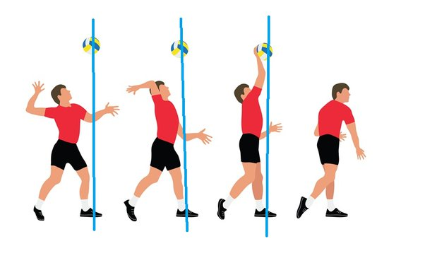
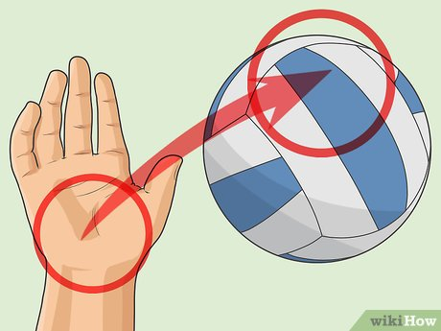
Subject Knowledge Organiser
Volleyball
Subject Knowledge
Overarm Serve: This is a serve in which the player tosses the ball with one hand and strikes it in the air above their head with the other hand. Make sure you contact the ball with an open palm.
Positioning: There are seven positions on a volleyball court: outside hitter, opposite setter, middle blocker, libero, defensive specialist, and serving specialist.
Key Terminology
Decision making
Strength
Speed
Agility
Co-ordination
Spatial awareness
Open palm
Bow and arrow
Tactics
What factors do we need to think when performing the overarm serve?
How can my team keep the ball after a serve?

Slide 12
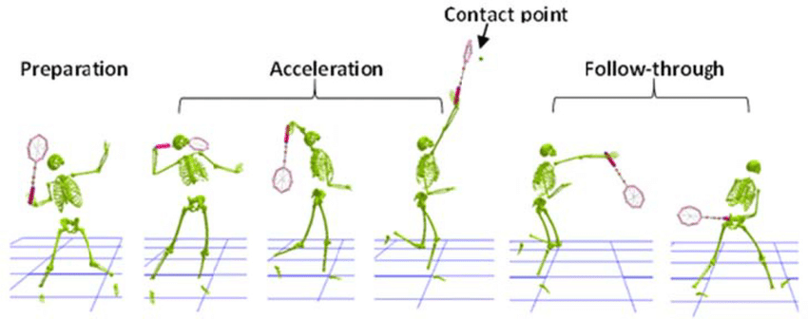
Subject Knowledge Organiser
Badminton
Subject Knowledge
Overhead Smash: This is an offensive shot that is intended to end the point on that shot. This shot has the same principles of an overhead clear but your wrist produces a snapping motion towards the net.
Forehand Drop Shot: This shot is used to draw your opponent to the front of the court. Your racket head needs to be slightly open before contact. You are slicing across the shuttlecock.
Key Terminology
Ready position
High contact point
Follow through
Decision making
Co-ordination
Spatial awareness
Awareness
Tactics
When would I use both of those shots?
What are the benefits of playing those shots?

Slide 13
Year 9 Half Term 3
Physical Education

Slide 14
Subject Knowledge Organiser
Football
Subject Knowledge
Set Pieces: Within the game, there are a few set pieces that are taken. They are: corners, direct and indirect free kicks, throw ins.
Block Tackle: This technique is the most commonly used in football. You watch the ball and wait for your opportunity to block the ball with the inside of your foot.
Key Terminology
Decision Making
Overloads
Creating Space
Body Shape
Balance
Spatial awareness
Co-ordination
Communication
Tactics
How can we score a goal from a set play?
How can I stop the shot in a conditioned game?

Slide 15
Subject Knowledge Organiser
Rugby
Subject Knowledge
High Ball Catch: This technique is used when the opposition put a high kick into the air. Make sure that you have a solid base and both your arms are pointing in the air. This creates the basket for the ball to land into.
Grubber Kick: This is an attacking kick used to either score a try or break the defensive line. Point the rugby ball towards the ground and use your laces to strike the ball.
Key Terminology
Accuracy
Reaction-time
Agility
Hand-eye co-ordination
Power
Finesse
Decision making
Tactics
Which type of kick should I use on the last tackle?
What can I do to make sure that I have a high completion rate of passes?

Slide 16
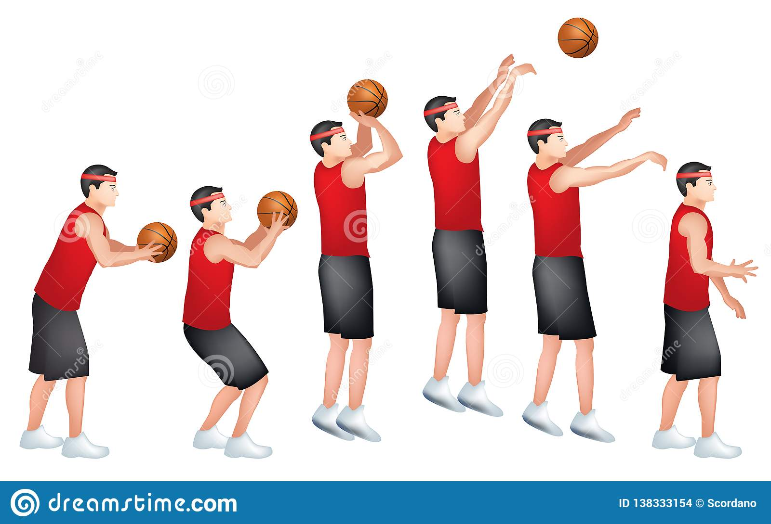
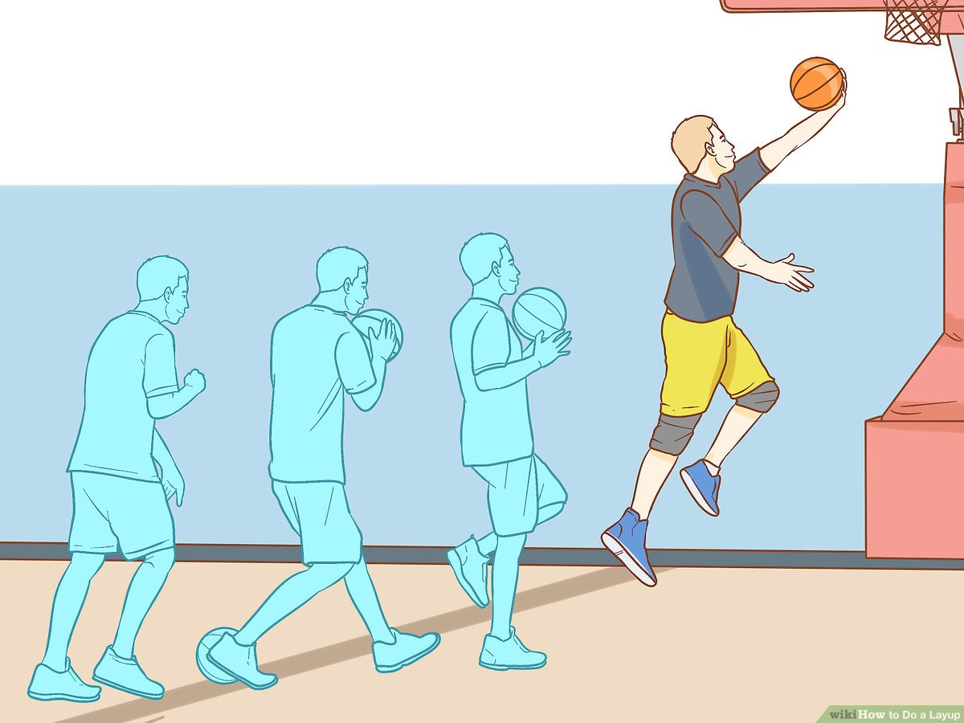
Subject Knowledge Organiser
Basketball
Subject Knowledge
Jump Shot: The purpose of the jump shot is to allow the shooter to take aim from a higher position and therefore prevent a defender from blocking the shot.
Lay Up: A lay-up provides a player with the opportunity to drive at the opponent's basket, jump close to the target and release the ball safely at the backboard. When used effectively it has the highest percentage chance of scoring points.
Key Terminology
Applying pressure
Footwork
Decision making
Strength
Speed
Agility
Co-ordination
Tactics
How can we create shooting opportunities?
How can we transition quickly from defense to attack?

Slide 17
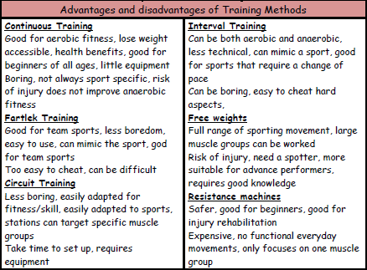
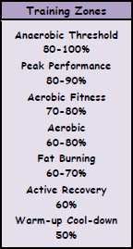
Subject Knowledge Organiser
Fitness
Training Methods
Training can be aerobic or anaerobic. In aerobic exercise, which is steady and not too fast, the heart is able to supply enough oxygen to the muscles. Aerobic training improves cardiovascular fitness. Anaerobic exercise is performed in short, fast bursts where the heart cannot supply enough oxygen to the muscles. Anaerobic training improves the ability of the muscles to work without enough oxygen when lactic acid is produced.
Specific training methods can be used to improve each fitness factor. Circuit training involves performing a series of exercises in a special order called a circuit. Each activity takes place at a 'station'. It can be designed to improve speed, agility, coordination, balance and muscular endurance. Continuous training involves working for a sustained period of time without rest. It improves cardio-vascular fitness. Cross training involves using another sport or activity to improve your fitness. It happens when an athlete trains in a different environment. For example a volleyball player uses the power training for that sport to help with fitness for long jump. Fartlek training or 'speed play' training involves varying your speed and the type of terrain over which you run, walk, cycle or ski. It improves aerobic and anaerobic fitness. Interval training involves alternating between periods of hard exercise and rest. It improves speed and muscular endurance. Weight training uses weights to provide resistance to the muscles. It improves muscular strength (high weight, low reps), muscular endurance (low weight, high reps, many sets) and power (medium weight and reps performed quickly).
Advantages and Disadvantages of Training Methods
Training Zones

Slide 18
Subject Knowledge Organiser
Badminton
Subject Knowledge
Overhead Smash: This is an offensive shot that is intended to end the point on that shot. This shot has the same principles of an overhead clear but your wrist produces a snapping motion towards the net.
Forehand Drop Shot: This shot is used to draw your opponent to the front of the court. Your racket head needs to be slightly open before contact. You are slicing across the shuttlecock.
Key Terminology
Ready position
High contact point
Follow through
Decision making
Co-ordination
Spatial awareness
Awareness
Tactics
When would I use both of those shots?
What are the benefits of playing those shots?

Slide 19
Year 9 Half Term 4
Physical Education

Slide 20
Subject Knowledge Organiser
Rugby
Subject Knowledge
High Ball Catch: This technique is used when the opposition put a high kick into the air. Make sure that you have a solid base and both your arms are pointing in the air. This creates the basket for the ball to land into.
Grubber Kick: This is an attacking kick used to either score a try or break the defensive line. Point the rugby ball towards the ground and use your laces to strike the ball.
Key Terminology
Accuracy
Reaction-time
Agility
Hand-eye co-ordination
Power
Finesse
Decision making
Tactics
Which type of kick should I use on the last tackle?
What can I do to make sure that I have a high completion rate of passes?

Slide 21
Subject Knowledge Organiser
Hockey
Subject Knowledge
Set Pieces: Within the game, there are a few set pieces that are taken. They are: short corners, penalty corners, hit in and restarts from a foul.
Outwitting the Opponent: Within any invasion game, you are always looking at creating opportunities to score a goal or create an overload in the attacking third.
Key Terminology
Applying pressure
Footwork
Decision making
Strength
Speed
Agility
Co-ordination
Spatial awareness
Tactics
What factors do we need to think about from a short corner?
How can we outwit the opponent on set plays?

Slide 22
Subject Knowledge Organiser
Badminton
Subject Knowledge
Overhead Smash: This is an offensive shot that is intended to end the point on that shot. This shot has the same principles of an overhead clear but your wrist produces a snapping motion towards the net.
Forehand Drop Shot: This shot is used to draw your opponent to the front of the court. Your racket head needs to be slightly open before contact. You are slicing across the shuttlecock.
Key Terminology
Ready position
High contact point
Follow through
Decision making
Co-ordination
Spatial awareness
Awareness
Tactics
When would I use both of those shots?
What are the benefits of playing those shots?

Slide 23
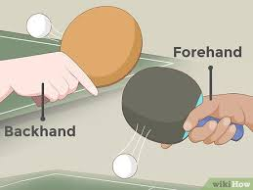
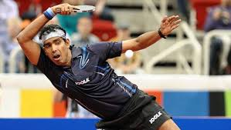
Subject Knowledge Organiser
Table Tennis
Tactics
How can I achieve a good serve?
When would I use a drive shot to win a point?
What shot should I select within a game when under pressure?
Subject Knowledge
Serving: Start with the bat and the ball together. Bat moves back with the ball moving forward. Arms are wide apart when the ball is tossed up. Contact point is to the side and in front of your body.
Forehand & Backhand: Solid base with your feet shoulder width apart. Turn the upper body when executing the shot. You use a swing action and not a swinging action to execute this shot correctly.
Key Terminology
Low to High
Contact Point
Preparatory phase
Execution Phase
Follow through Phase
Ball toss
Co-ordination

Slide 24
Subject Knowledge Organiser
Volleyball
Subject Knowledge
Overarm Serve: This is a serve in which the player tosses the ball with one hand and strikes it in the air above their head with the other hand. Make sure you contact the ball with an open palm.
Positioning: There are seven positions on a volleyball court: outside hitter, opposite setter, middle blocker, libero, defensive specialist, and serving specialist.
Key Terminology
Decision making
Strength
Speed
Agility
Co-ordination
Spatial awareness
Open palm
Bow and arrow
Tactics
What factors do we need to think when performing the overarm serve?
How can my team keep the ball after a serve?

Slide 25
Subject Knowledge Organiser
Football
Subject Knowledge
Set Pieces: Within the game, there are a few set pieces that are taken. They are: corners, direct and indirect free kicks, throw ins.
Block Tackle: This technique is the most commonly used in football. You watch the ball and wait for your opportunity to block the ball with the inside of your foot.
Key Terminology
Decision Making
Overloads
Creating Space
Body Shape
Balance
Spatial awareness
Co-ordination
Communication
Tactics
How can we score a goal from a set play?
How can I stop the shot in a conditioned game?

Slide 26
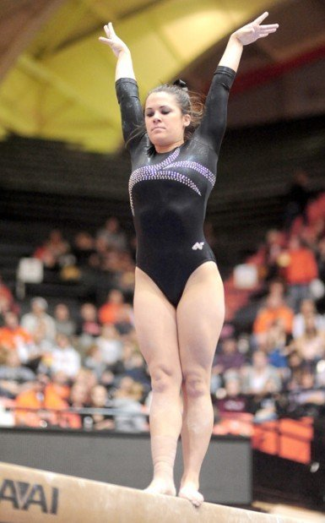
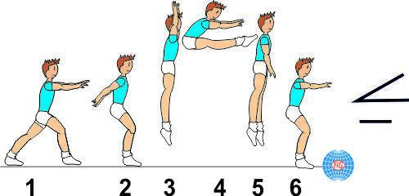
Subject Knowledge Organiser
Gymnastics
Subject Knowledge
Agilities: This is how you can adapt your routines to suit the needs of your partner. For example, forward rolls, pike jumps, backwards rolls.
Standards: You are expected to sit in the ready position. You put your hands flat on the floor, behind your back. Your sat with your legs out in front of you and your toes are pointing. You finish your routines with your hands in the air and on your tippy toes.
Key Terminology
Aesthetic Appreciation
Balance
Flexibility
Agility
Body tension
Core strength

Slide 27
Year 9 Half Term 5
Physical Education

Slide 28
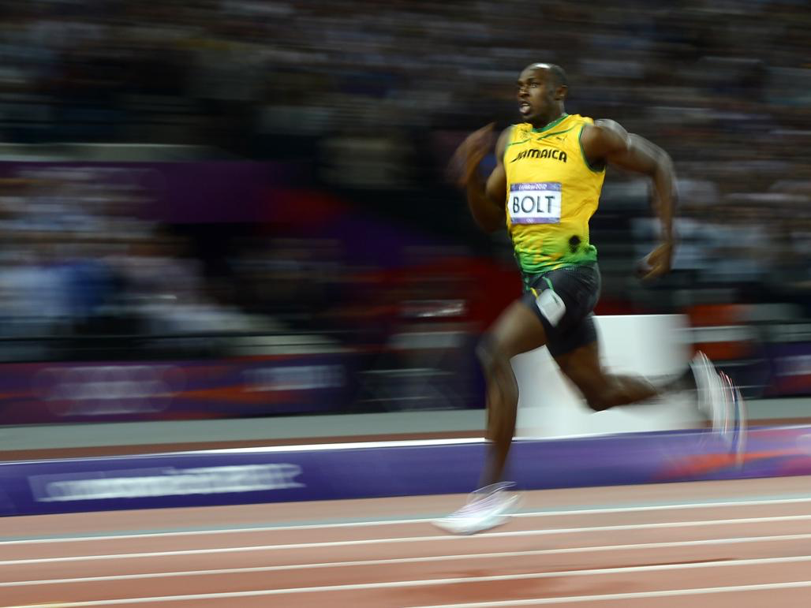
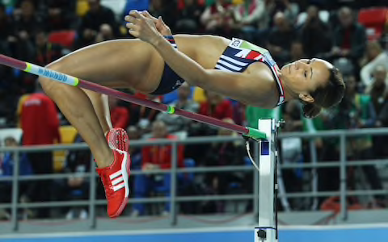
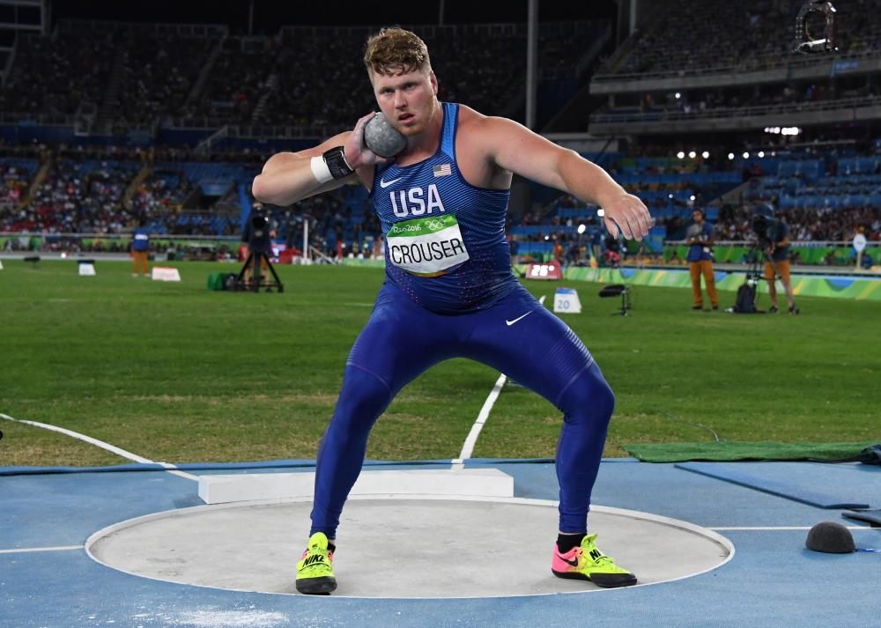

Subject Knowledge Organiser
Athletics – Track, Jump & Throw
Sprint
This track event is a short running race. There are generally three different sprint distances: 100m, 200m, and 400m.
Drive phase
The drive is where you are looking to cover as much ground as possible through each stride, pushing with the leg that is in contact with the ground and driving the free leg through. In this phase the head must follow the body.
Transition phase
This transition phase is when you smoothly and gradually come upright into your stride. This is when you start move at a slightly faster tempo and begin to reach top speed.
Fly phase
The fly phase is when you are fully upright and at top speed. The key to maintaining as much top end speed as possible is a relaxed upper body and a quick foot contact and tempo.
High jump
This jumping event requires athletes to jump over the bar using the Fosbury Flop technique.
Stage one
Start 8-10 strides away from the barrier. Run in a curve with controlled speed. Lean your torso into the curve, the opposite side to the barrier. Keep your shoulder as high as possible.
Stage two
You are ready to jump at approximately one metre past the first post and an arm's length away from the mat. At this point, plant the take-off foot down. At the same time, drive your lead leg and arms upwards and shoulders high.
Stage three
In the air, keep driving upwards and bring your lead knee across the body to get shoulders parallel with the bar. Bring the arms forwards and back into the body. As your hips cross the barrier, flick your feet upwards and high over the barrier. Maintain balance and land safely.
Shot put
This throwing event requires athletes to throw a heavy metal ball called a shot as far as possible.
Stage one
Hold the shot at the bottom and place the thumb and little finger each side of the shot. Place the shot under the chin and touching the neck. Keep the throwing arm elbow high and the arm parallel to the floor. Stand on the balls of your feet with your knees bent and non-throwing shoulder pointing towards the throwing area.
Stage two
Lean backwards and place your weight on the back foot. Transfer the weight from the back leg to the front leg. Explode upwards, bring the hips around and forwards to face throwing area. Extend the throwing arm up quickly and powerfully. Finish with chest and head up.

Slide 29
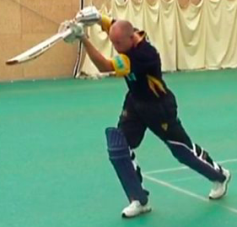
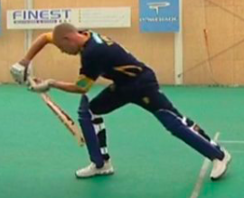
Subject Knowledge Organiser
Cricket – Bowling, Batting & Fielding
Overarm bowl
An overarm bowl is the legal way to deliver a ball in a competitive game of cricket.
Stage one
As you run in towards the wicket, keep your arms close to your body, your head steady and your eyes fixed on the batter.
Stage two
As you approach the crease, start turning your body so your shoulder is facing towards the wicket and lean back slightly.
Stage three
On arrival at the release point, keep the ball close to your chin and your non-bowling arm up with your elbow pointing towards the target. As your back foot lands before the popping crease line, keep your body upright and raise your front foot pointing your knee towards the target. As your front foot lands, your toes should be pointing to the batsperson.
Stage four
On releasing the ball, rotate your shoulders and push your bowling arm forward and down from the coil position. The non-bowling arm should be pointing to the batter. Your arms should then rotate through with the ball and release it at the top of the delivery arc. Continue to follow through and maintain a visual on the batsperson.
Straight drive
A straight drive is a deliberate shot that aims to hit the ball along the ground to prevent being caught out.
Forward defensive
A forward defensive is a deliberate shot that aims to prevent the ball from hitting the wicket or the player's pads.
Overarm throw
An overarm throw is the fastest and
most accurate way to pass a ball.
Stage one
Stand shoulder width apart, sideways on to the target, on the balls of your feet with the weight transferred to the back foot. The throwing arm is taken back behind the head at a 90° angle.
Point the non-throwing arm at the target.
Stage two
Transfer the weight from your back foot to your front foot by rotating your hips and torso toward the target. Pull the throwing arm through toward the target leading with your elbow and your forearm and wrist following last and fast. Release the ball just in front of your head with both feet on the ground and the chest facing the target.
Long barrier
The long barrier is the safest technique to control a cricket ball travelling along the ground.
Stage one
Get in line with the ball and get your whole body behind the ball. As quickly as possible bend both knees and twist sideways so that the knee of your strong leg touches the ground and touches the back of the heel of the other leg. Extend arms downwards, spread hands wide with little fingers touching each other. Pick up the ball.

Slide 30
Subject Knowledge Organiser
Rounders – Bowling, Batting & Fielding
Under Arm Bowl
This is how the bowler will bowl the ball to the batter
Stage one
The bowler will stand in the bowling square and line themselves up with the batter, their position in the square might change depending on whether the batter is right or left handed. They will take the ball in their most dominant hand
Stage 2
The bowler will step forward with their opposite foot to the hand that the ball is in e.g. if they are right handed, the bowler will step forward with their left foot. At the same time that they are doing this they will move their bowling arm backwards, as their weight transfers from their back foot to their front foot; they will move their bowling arm forward to release the ball towards their target area – the batter.
Progressions
The bowler can make batting more challenging for the batter, by increasing the speed of the ball they bowl, they can also add spin to the ball and experiment by bowling the ball at different heights.
Batting
Stage One
The batter will take the bat in their most dominant hand, they will enter the batting box and stand sideways on and extend their batting arm.
Stage two
The batter will need to time their swing so that they make good contact with the ball – keeping their eye on the ball they will move their bat backwards and then forwards to make contact with the ball. The batter is aiming make contact with the middle of the ball – if they make contact with the top of the ball, it will not travel far and if they make contact with the bottom of the ball, it will go high into the air and will run the risk of being caught out.
Progressions
The batter will want to make it difficult for the fielding team to field the ball, so they want to hit the ball far and also aim for the areas that are not covered by fielders
Overarm throw
An overarm throw is the fastest and most accurate way to pass a ball.
Stage one
Stand shoulder width apart, sideways on to the target, on the balls of your feet with the weight transferred to the back foot. The throwing arm is taken back behind the head at a 90° angle.
Point the non-throwing arm at the target.
Stage two
Transfer the weight from your back foot to your front foot by rotating your hips and torso toward the target. Pull the throwing arm through toward the target leading with your elbow and your forearm and wrist following last and fast. Release the ball just in front of your head with both feet on the ground and the chest facing the target.
Long barrier
The long barrier is the safest technique to control a cricket ball travelling along the ground.
Stage one
Get in line with the ball and get your whole body behind the ball. As quickly as possible bend both knees and twist sideways so that the knee of your strong leg touches the ground and touches the back of the heel of the other leg. Extend arms downwards, spread hands wide with little fingers touching each other. Pick up the ball.

Slide 31
Subject Knowledge Organiser
Softball – Bowling, Batting & Fielding
Under Arm Bowl
This is how the bowler will bowl the ball to the batter
Stage one
The bowler will stand in the bowling square and line themselves up with the batter, their position in the square might change depending on whether the batter is right or left handed. They will take the ball in their most dominant hand
Stage 2
The bowler will step forward with their opposite foot to the hand that the ball is in e.g. if they are right handed, the bowler will step forward with their left foot. At the same time that they are doing this they will move their bowling arm backwards, as their weight transfers from their back foot to their front foot; they will move their bowling arm forward to release the ball towards their target area – the batter.
Progressions
The bowler can make batting more challenging for the batter, by increasing the speed of the ball they bowl, they can also add spin to the ball and experiment by bowling the ball at different heights.
Batting
Stage One
The batter will take the bat in their most dominant hand, they will enter the batting box and stand sideways on and extend their batting arm.
Stage two
The batter will need to time their swing so that they make good contact with the ball – keeping their eye on the ball they will move their bat backwards and then forwards to make contact with the ball. The batter is aiming make contact with the middle of the ball – if they make contact with the top of the ball, it will not travel far and if they make contact with the bottom of the ball, it will go high into the air and will run the risk of being caught out.
Progressions
The batter will want to make it difficult for the fielding team to field the ball, so they want to hit the ball far and also aim for the areas that are not covered by fielders
Overarm throw
An overarm throw is the fastest and most accurate way to pass a ball.
Stage one
Stand shoulder width apart, sideways on to the target, on the balls of your feet with the weight transferred to the back foot. The throwing arm is taken back behind the head at a 90° angle.
Point the non-throwing arm at the target.
Stage two
Transfer the weight from your back foot to your front foot by rotating your hips and torso toward the target. Pull the throwing arm through toward the target leading with your elbow and your forearm and wrist following last and fast. Release the ball just in front of your head with both feet on the ground and the chest facing the target.
Long barrier
The long barrier is the safest technique to control a cricket ball travelling along the ground.
Stage one
Get in line with the ball and get your whole body behind the ball. As quickly as possible bend both knees and twist sideways so that the knee of your strong leg touches the ground and touches the back of the heel of the other leg. Extend arms downwards, spread hands wide with little fingers touching each other. Pick up the ball.

Slide 32
Year 9 Half Term 6
Physical Education

Slide 33
Subject Knowledge Organiser
Athletics – Track, Jump & Throw
Sprint
This track event is a short running race. There are generally three different sprint distances: 100m, 200m, and 400m.
Drive phase
The drive is where you are looking to cover as much ground as possible through each stride, pushing with the leg that is in contact with the ground and driving the free leg through. In this phase the head must follow the body.
Transition phase
This transition phase is when you smoothly and gradually come upright into your stride. This is when you start move at a slightly faster tempo and begin to reach top speed.
Fly phase
The fly phase is when you are fully upright and at top speed. The key to maintaining as much top end speed as possible is a relaxed upper body and a quick foot contact and tempo.
High jump
This jumping event requires athletes to jump over the bar using the Fosbury Flop technique.
Stage one
Start 8-10 strides away from the barrier. Run in a curve with controlled speed. Lean your torso into the curve, the opposite side to the barrier. Keep your shoulder as high as possible.
Stage two
You are ready to jump at approximately one metre past the first post and an arm's length away from the mat. At this point, plant the take-off foot down. At the same time, drive your lead leg and arms upwards and shoulders high.
Stage three
In the air, keep driving upwards and bring your lead knee across the body to get shoulders parallel with the bar. Bring the arms forwards and back into the body. As your hips cross the barrier, flick your feet upwards and high over the barrier. Maintain balance and land safely.
Shot put
This throwing event requires athletes to throw a heavy metal ball called a shot as far as possible.
Stage one
Hold the shot at the bottom and place the thumb and little finger each side of the shot. Place the shot under the chin and touching the neck. Keep the throwing arm elbow high and the arm parallel to the floor. Stand on the balls of your feet with your knees bent and non-throwing shoulder pointing towards the throwing area.
Stage two
Lean backwards and place your weight on the back foot. Transfer the weight from the back leg to the front leg. Explode upwards, bring the hips around and forwards to face throwing area. Extend the throwing arm up quickly and powerfully. Finish with chest and head up.

Slide 34
Subject Knowledge Organiser
Cricket – Bowling, Batting & Fielding
Overarm bowl
An overarm bowl is the legal way to deliver a ball in a competitive game of cricket.
Stage one
As you run in towards the wicket, keep your arms close to your body, your head steady and your eyes fixed on the batter.
Stage two
As you approach the crease, start turning your body so your shoulder is facing towards the wicket and lean back slightly.
Stage three
On arrival at the release point, keep the ball close to your chin and your non-bowling arm up with your elbow pointing towards the target. As your back foot lands before the popping crease line, keep your body upright and raise your front foot pointing your knee towards the target. As your front foot lands, your toes should be pointing to the batsperson.
Stage four
On releasing the ball, rotate your shoulders and push your bowling arm forward and down from the coil position. The non-bowling arm should be pointing to the batter. Your arms should then rotate through with the ball and release it at the top of the delivery arc. Continue to follow through and maintain a visual on the batsperson.
Straight drive
A straight drive is a deliberate shot that aims to hit the ball along the ground to prevent being caught out.
Forward defensive
A forward defensive is a deliberate shot that aims to prevent the ball from hitting the wicket or the player's pads.
Overarm throw
An overarm throw is the fastest and
most accurate way to pass a ball.
Stage one
Stand shoulder width apart, sideways on to the target, on the balls of your feet with the weight transferred to the back foot. The throwing arm is taken back behind the head at a 90° angle.
Point the non-throwing arm at the target.
Stage two
Transfer the weight from your back foot to your front foot by rotating your hips and torso toward the target. Pull the throwing arm through toward the target leading with your elbow and your forearm and wrist following last and fast. Release the ball just in front of your head with both feet on the ground and the chest facing the target.
Long barrier
The long barrier is the safest technique to control a cricket ball travelling along the ground.
Stage one
Get in line with the ball and get your whole body behind the ball. As quickly as possible bend both knees and twist sideways so that the knee of your strong leg touches the ground and touches the back of the heel of the other leg. Extend arms downwards, spread hands wide with little fingers touching each other. Pick up the ball.

Slide 35
Subject Knowledge Organiser
Rounders – Bowling, Batting & Fielding
Under Arm Bowl
This is how the bowler will bowl the ball to the batter
Stage one
The bowler will stand in the bowling square and line themselves up with the batter, their position in the square might change depending on whether the batter is right or left handed. They will take the ball in their most dominant hand
Stage 2
The bowler will step forward with their opposite foot to the hand that the ball is in e.g. if they are right handed, the bowler will step forward with their left foot. At the same time that they are doing this they will move their bowling arm backwards, as their weight transfers from their back foot to their front foot; they will move their bowling arm forward to release the ball towards their target area – the batter.
Progressions
The bowler can make batting more challenging for the batter, by increasing the speed of the ball they bowl, they can also add spin to the ball and experiment by bowling the ball at different heights.
Batting
Stage One
The batter will take the bat in their most dominant hand, they will enter the batting box and stand sideways on and extend their batting arm.
Stage two
The batter will need to time their swing so that they make good contact with the ball – keeping their eye on the ball they will move their bat backwards and then forwards to make contact with the ball. The batter is aiming make contact with the middle of the ball – if they make contact with the top of the ball, it will not travel far and if they make contact with the bottom of the ball, it will go high into the air and will run the risk of being caught out.
Progressions
The batter will want to make it difficult for the fielding team to field the ball, so they want to hit the ball far and also aim for the areas that are not covered by fielders
Overarm throw
An overarm throw is the fastest and most accurate way to pass a ball.
Stage one
Stand shoulder width apart, sideways on to the target, on the balls of your feet with the weight transferred to the back foot. The throwing arm is taken back behind the head at a 90° angle.
Point the non-throwing arm at the target.
Stage two
Transfer the weight from your back foot to your front foot by rotating your hips and torso toward the target. Pull the throwing arm through toward the target leading with your elbow and your forearm and wrist following last and fast. Release the ball just in front of your head with both feet on the ground and the chest facing the target.
Long barrier
The long barrier is the safest technique to control a cricket ball travelling along the ground.
Stage one
Get in line with the ball and get your whole body behind the ball. As quickly as possible bend both knees and twist sideways so that the knee of your strong leg touches the ground and touches the back of the heel of the other leg. Extend arms downwards, spread hands wide with little fingers touching each other. Pick up the ball.

Slide 36
Subject Knowledge Organiser
Softball – Bowling, Batting & Fielding
Under Arm Bowl
This is how the bowler will bowl the ball to the batter
Stage one
The bowler will stand in the bowling square and line themselves up with the batter, their position in the square might change depending on whether the batter is right or left handed. They will take the ball in their most dominant hand
Stage 2
The bowler will step forward with their opposite foot to the hand that the ball is in e.g. if they are right handed, the bowler will step forward with their left foot. At the same time that they are doing this they will move their bowling arm backwards, as their weight transfers from their back foot to their front foot; they will move their bowling arm forward to release the ball towards their target area – the batter.
Progressions
The bowler can make batting more challenging for the batter, by increasing the speed of the ball they bowl, they can also add spin to the ball and experiment by bowling the ball at different heights.
Batting
Stage One
The batter will take the bat in their most dominant hand, they will enter the batting box and stand sideways on and extend their batting arm.
Stage two
The batter will need to time their swing so that they make good contact with the ball – keeping their eye on the ball they will move their bat backwards and then forwards to make contact with the ball. The batter is aiming make contact with the middle of the ball – if they make contact with the top of the ball, it will not travel far and if they make contact with the bottom of the ball, it will go high into the air and will run the risk of being caught out.
Progressions
The batter will want to make it difficult for the fielding team to field the ball, so they want to hit the ball far and also aim for the areas that are not covered by fielders
Overarm throw
An overarm throw is the fastest and most accurate way to pass a ball.
Stage one
Stand shoulder width apart, sideways on to the target, on the balls of your feet with the weight transferred to the back foot. The throwing arm is taken back behind the head at a 90° angle.
Point the non-throwing arm at the target.
Stage two
Transfer the weight from your back foot to your front foot by rotating your hips and torso toward the target. Pull the throwing arm through toward the target leading with your elbow and your forearm and wrist following last and fast. Release the ball just in front of your head with both feet on the ground and the chest facing the target.
Long barrier
The long barrier is the safest technique to control a cricket ball travelling along the ground.
Stage one
Get in line with the ball and get your whole body behind the ball. As quickly as possible bend both knees and twist sideways so that the knee of your strong leg touches the ground and touches the back of the heel of the other leg. Extend arms downwards, spread hands wide with little fingers touching each other. Pick up the ball.

